Slide 1

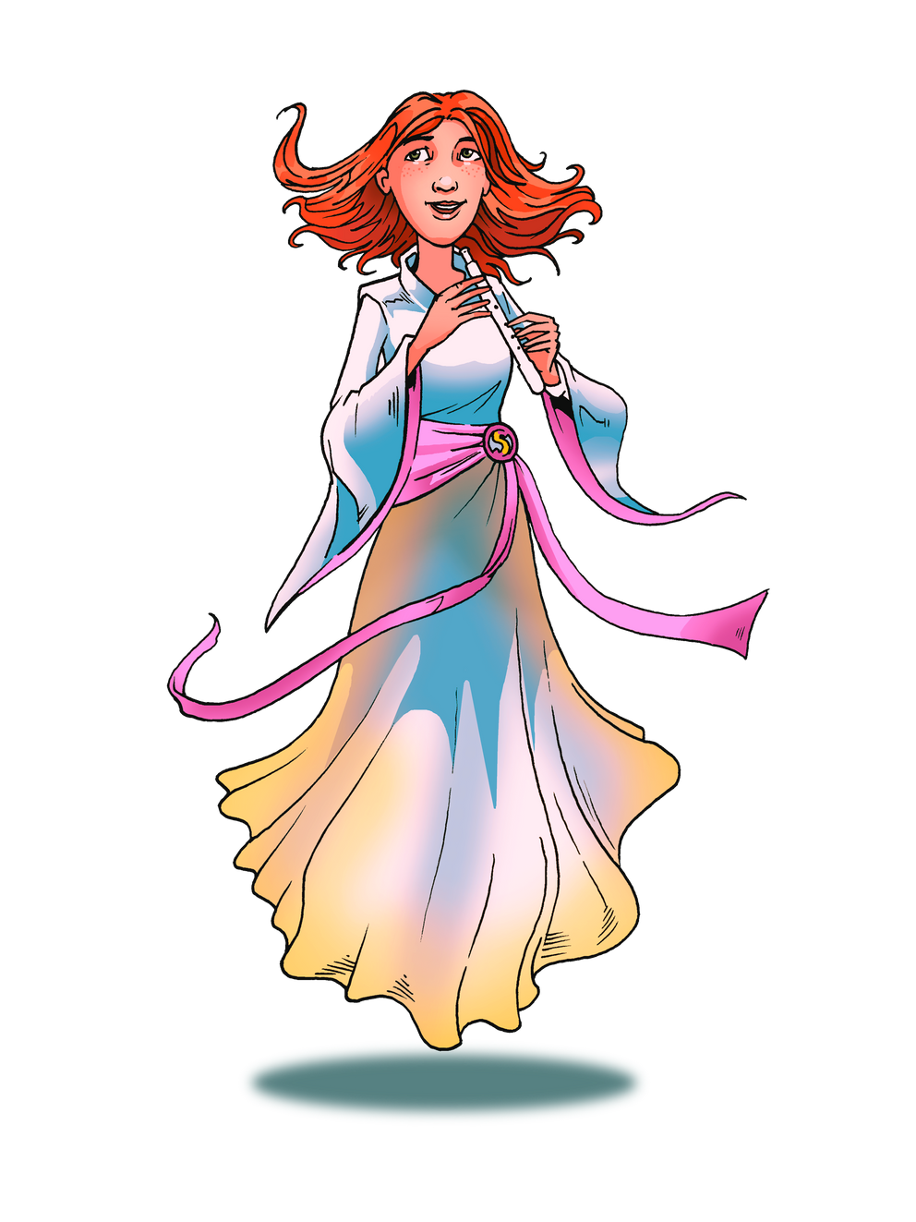


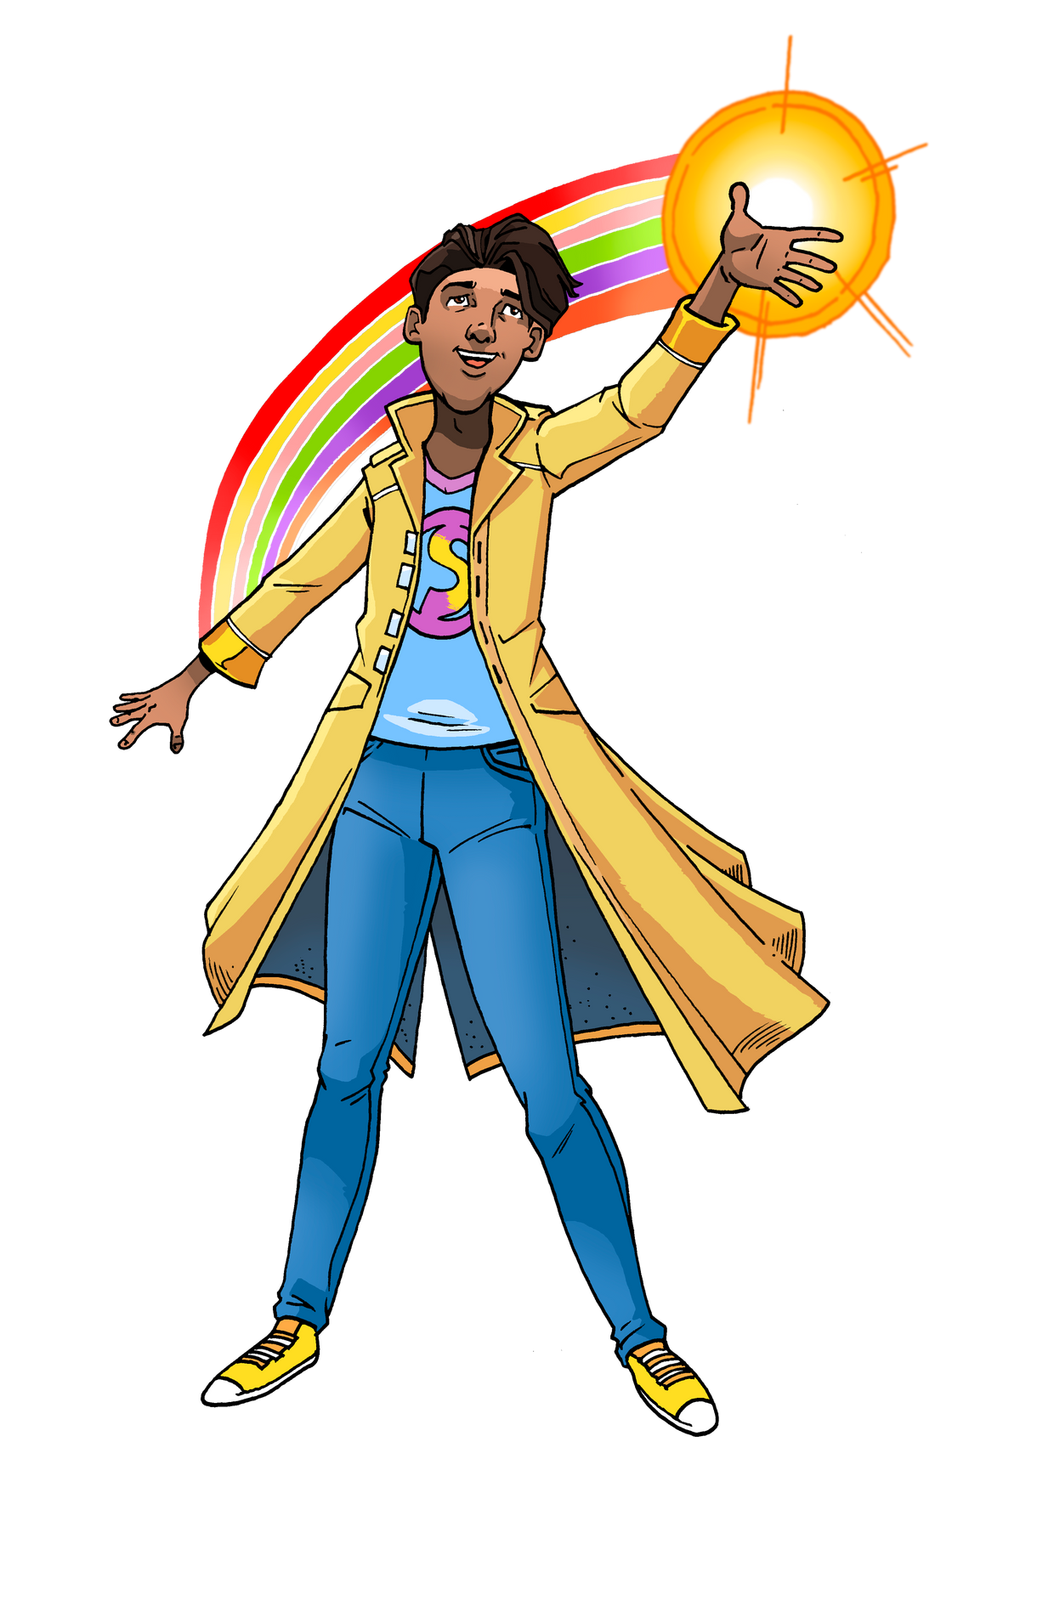

Know Yourself, Grow Yourself
Children’s Mental Health Week 2025
Understanding sustainability and
empowering ourselves
for a brighter future

Slide 2
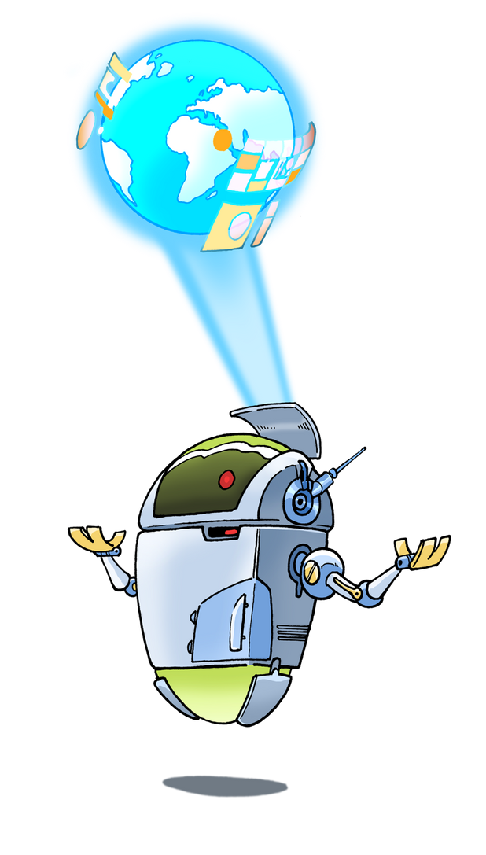

Knowing yourself means understanding
your strengths,
emotions, and
what you care about.
Growing yourself
means taking small steps
to improve, make a difference,
and feel empowered.
What Does "Know Yourself, Grow Yourself" Mean?
Today, we’ll link this to sustainability,
climate action, and how we can all help our planet.

Slide 3
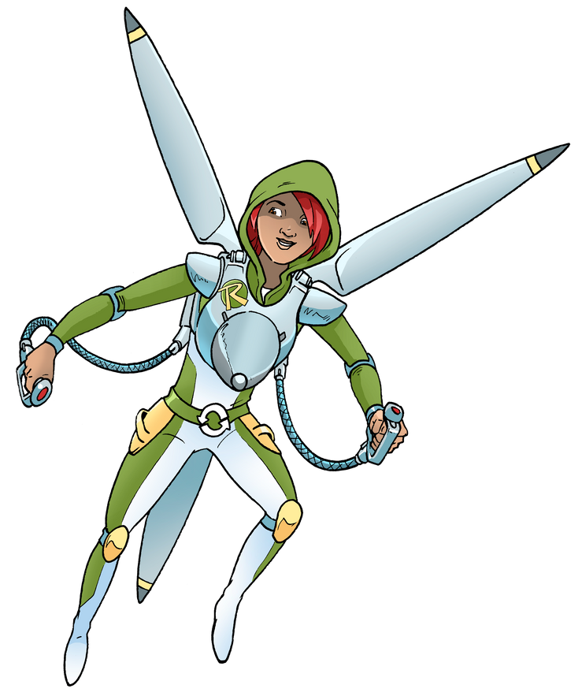
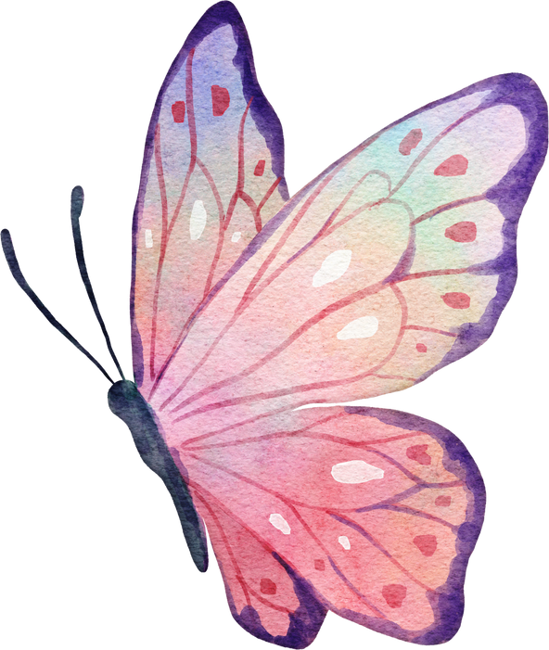
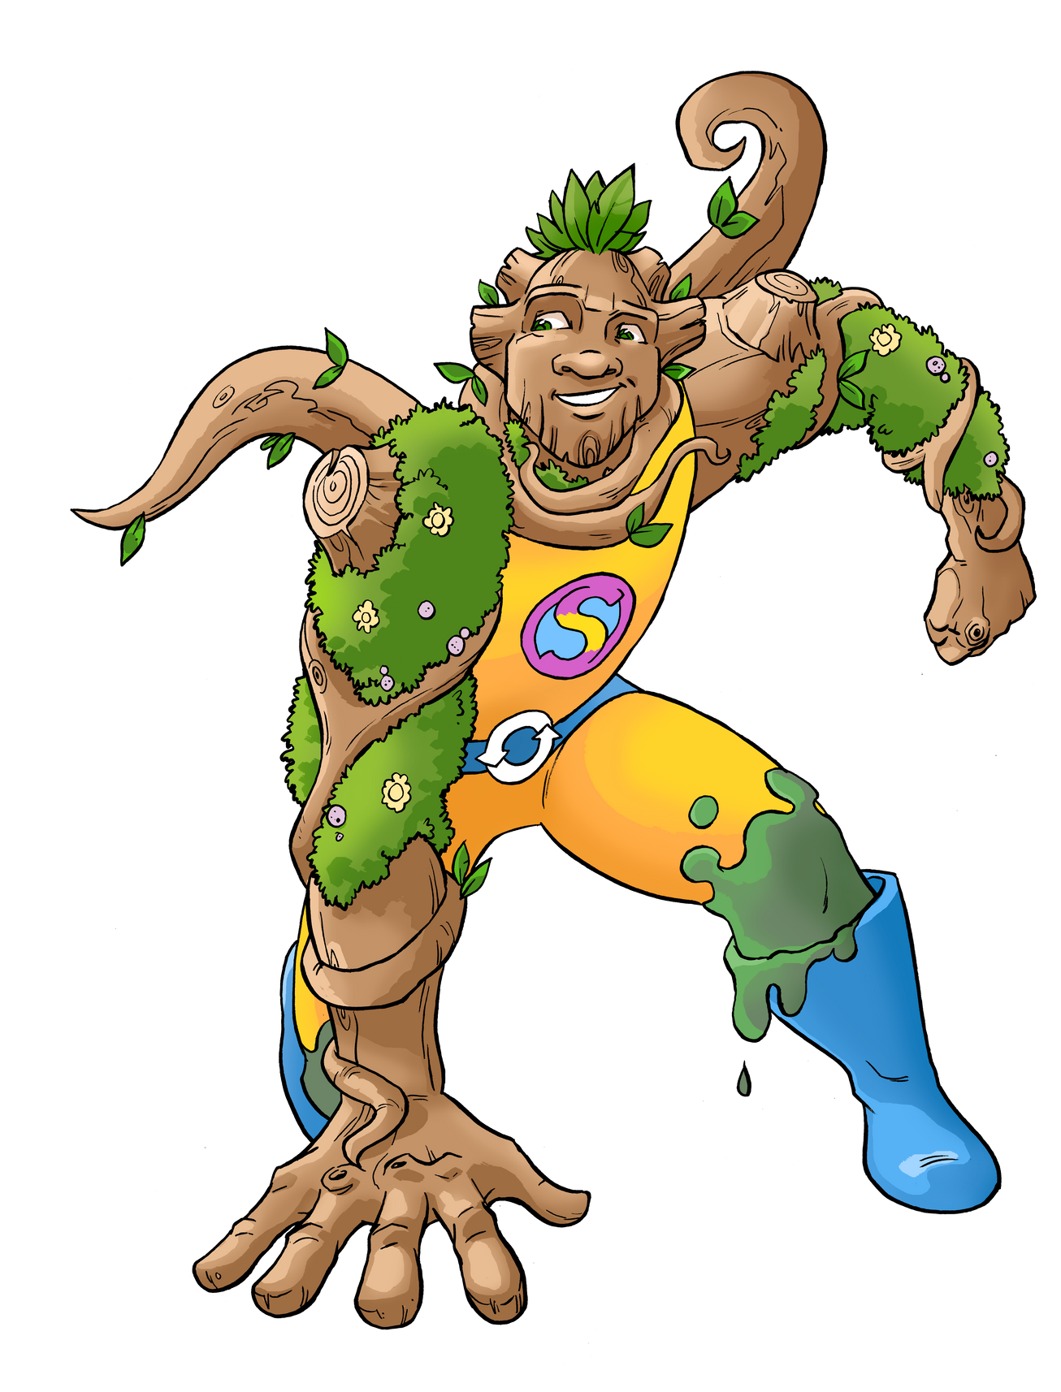


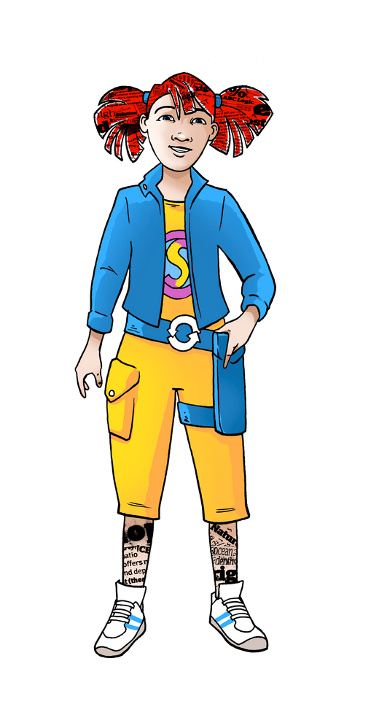
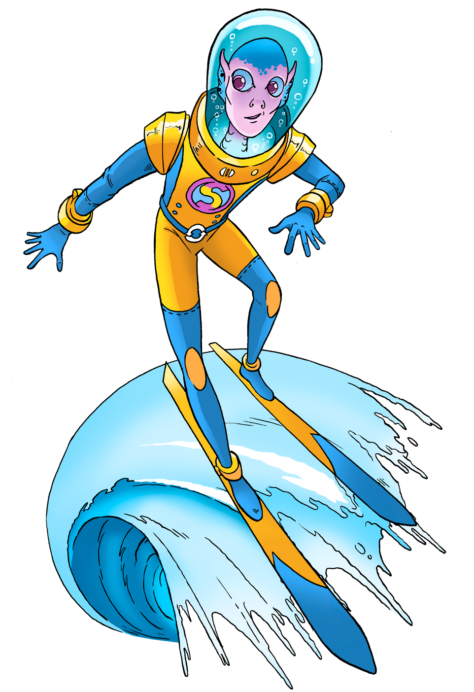
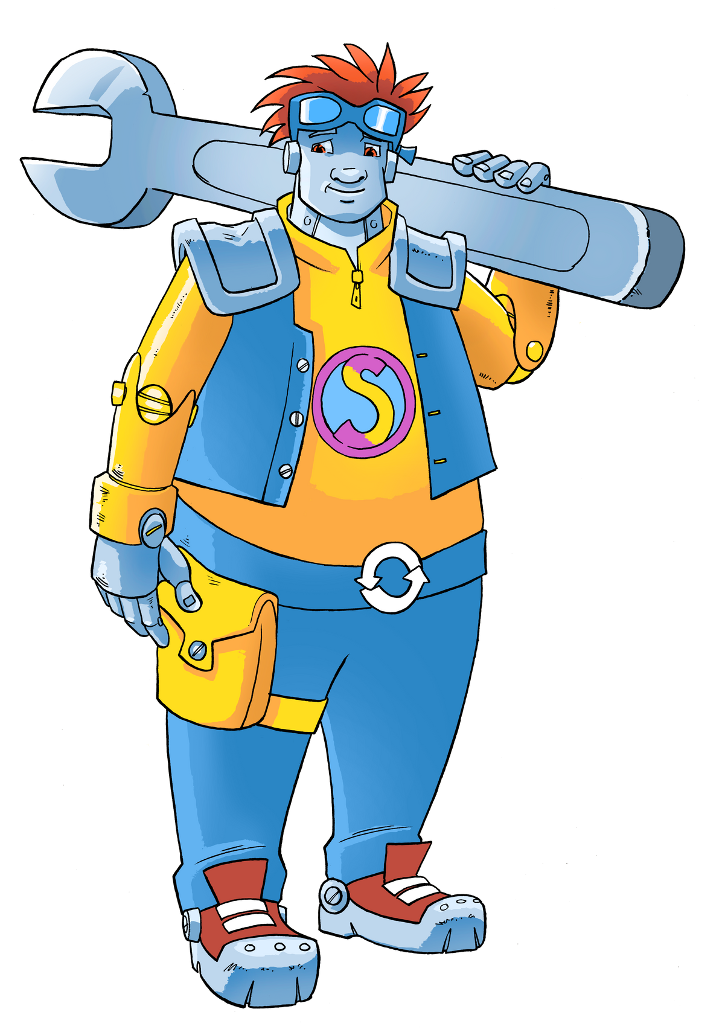
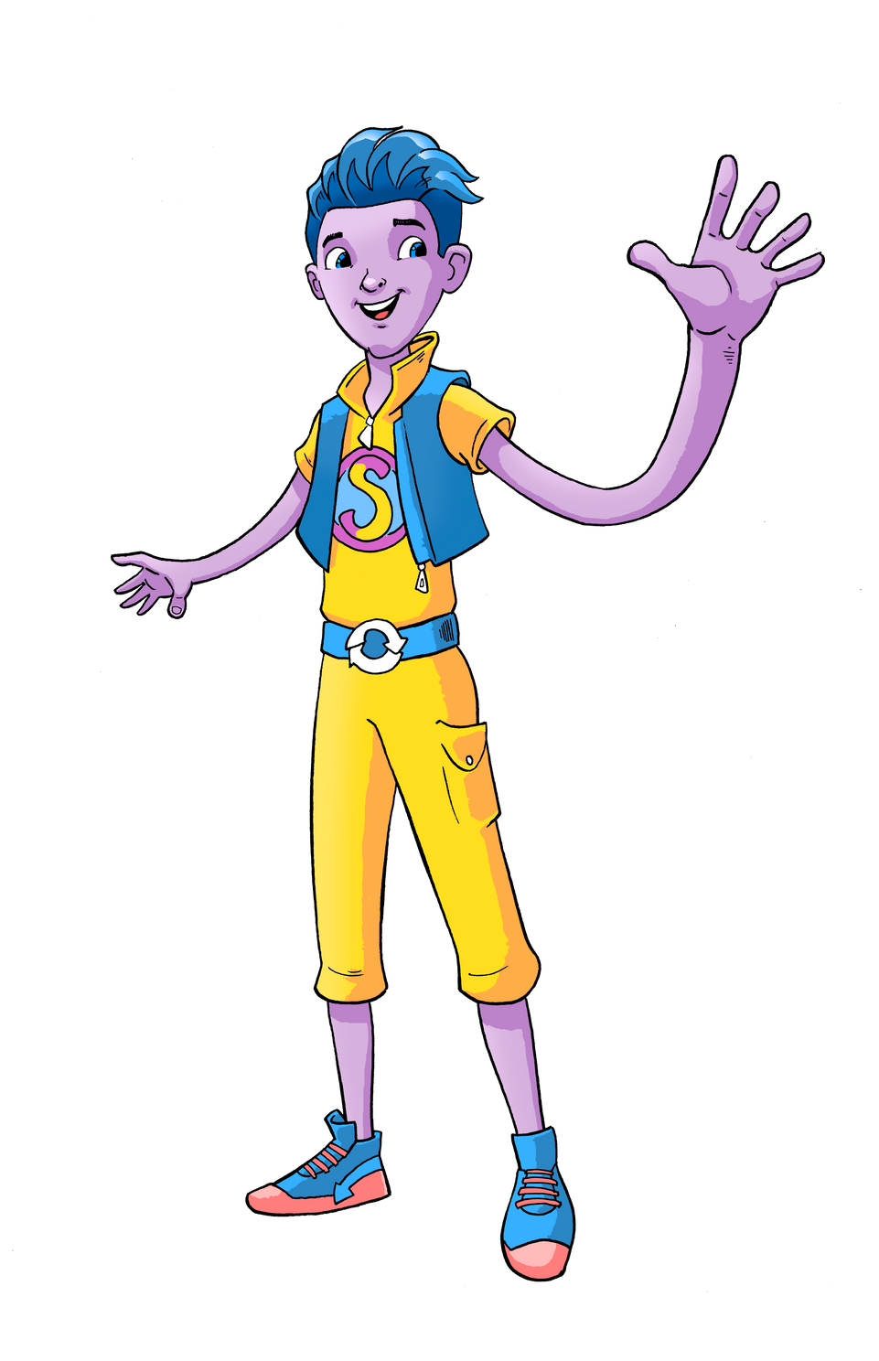
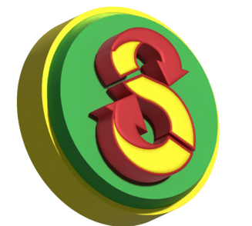
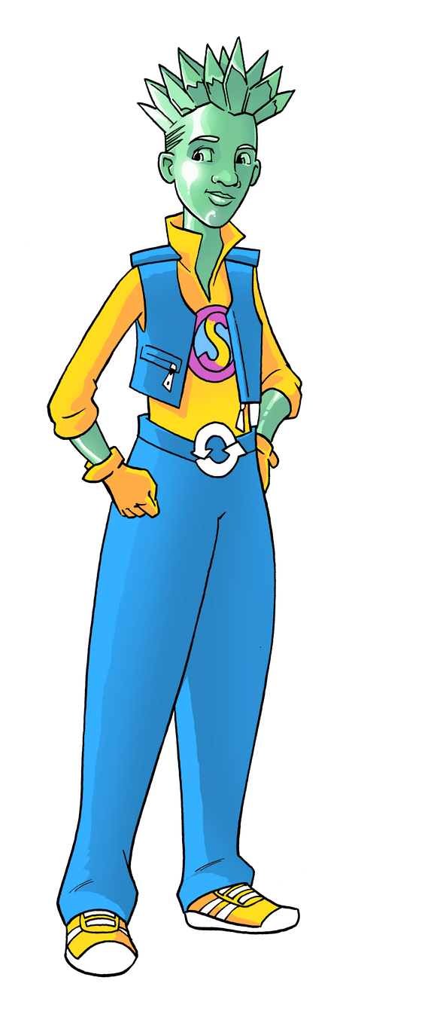
What is Sustainability?
Living in Harmony with Our Planet
Land, Air & Water
Sustainability means using Earth’s resources
wisely so future generations can enjoy them too.
It includes reducing waste, recycling, and protecting nature.
It’s about making choices that are good for you and the planet.

Slide 4
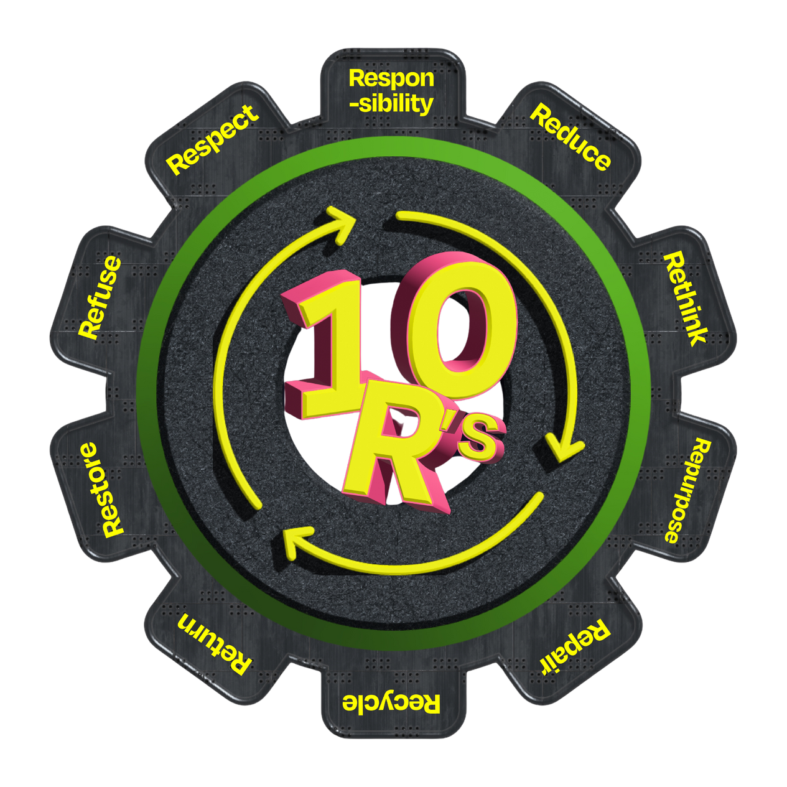
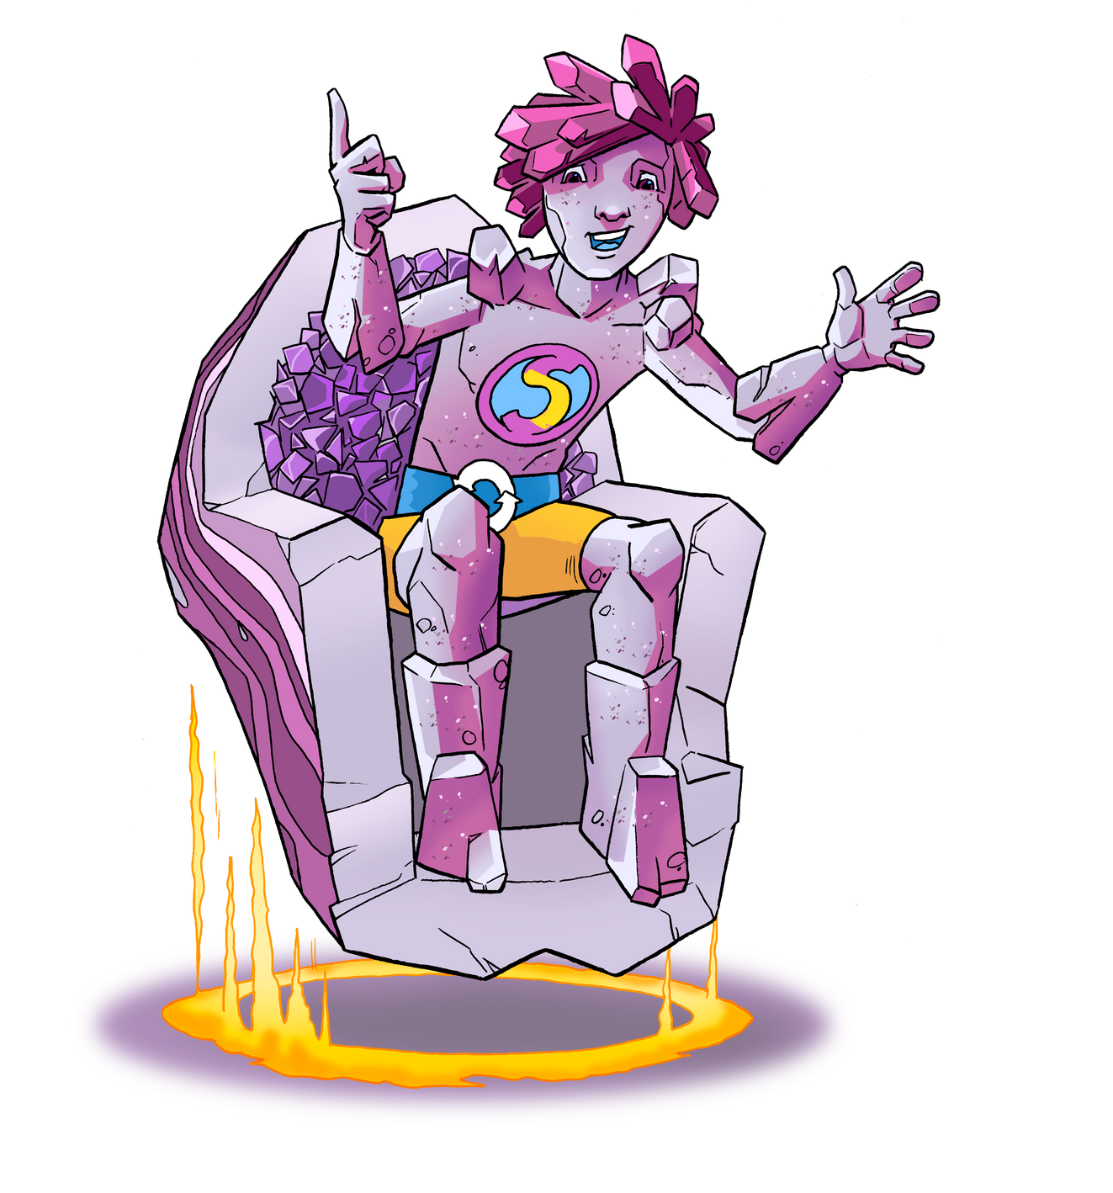
"Can you think of something
you’ve reused or recycled?"
What is the Circular Economy?
The circular economy is a way of thinking
where nothing is wasted.
Items are reused, recycled,
or made into something new.
An Example -
Turning old plastic bottles
into new clothes, plastic bottles or playgrounds.

Slide 5
What is Climate Anxiety?
Climate anxiety is feeling worried about the future of our planet.
It’s okay to feel this way,
but we can turn those feelings into action.
By taking small steps,
we can make a big difference and feel more in control.
How can you take control,
let’s find out how you can make a difference ?

Slide 6
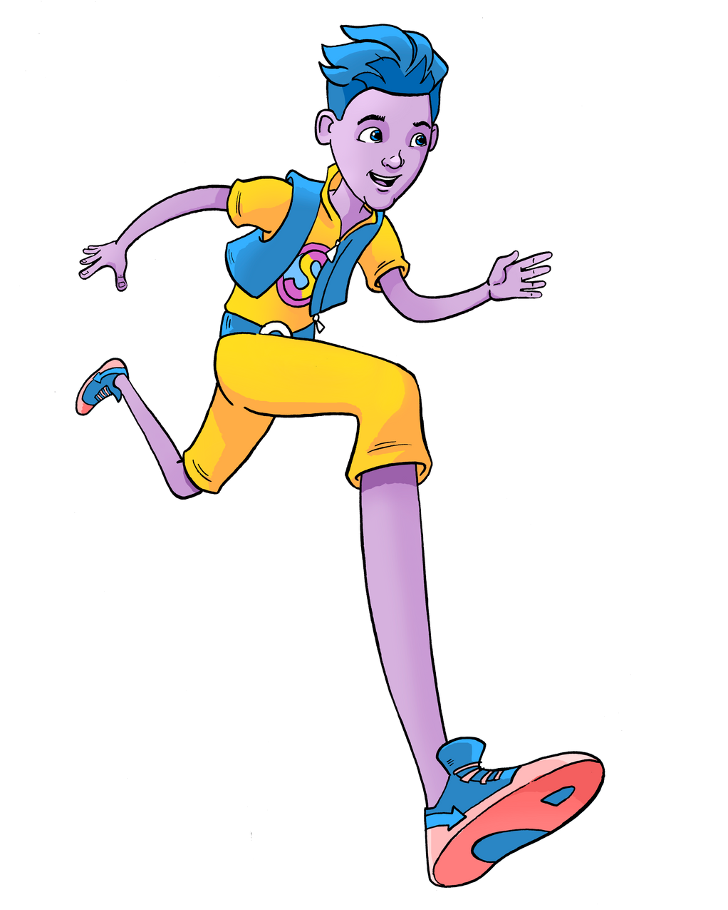
"What’s one thing you
can do today to
help the planet?"
How Can We Make a Difference?
Learn about sustainability and share your knowledge.
Take action: recycle, use less plastic & recycle what you can , and conserve energy.
Work together: small actions add up when we all pitch in.
Find out more ways that you can act in a
sustainable way to protect
our biosphere and its resources

Slide 7
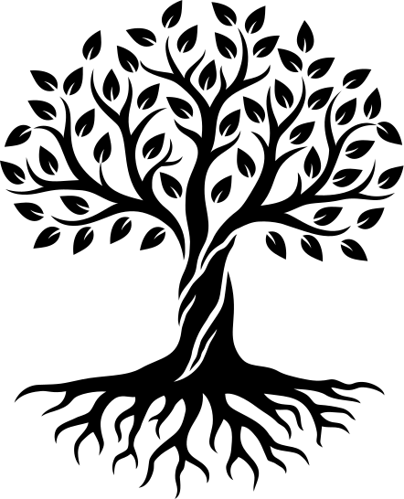
How Does This Help Us Grow?
Helping the planet makes us feel proud and strong.
It teaches us to solve problems and work as a team.
We learn that we have the power to make a difference.
You can be the change and influence others . Be a changemaker !

Slide 8
Let’s Discover Our Strengths
Write down:
One thing you’re good at (your strength).
One way you can use it to help the planet.
One action you will take this week.
Share with a partner and celebrate your ideas.

Slide 9


Tips for Sustainability and Wellbeing
Stay curious: Keep learning about ways to help the planet.
Stay positive: Focus on what you can do, not what you can’t.
Take care of yourself: Rest, eat well, and spend time in nature.
Celebrate every small success.
"Learn,"
"Act,"
"Care,"
"Celebrate."
"share three successes and how they made you feel.
Did they support others too? ."

Slide 10
What Did We Learn Today?
Knowing yourself helps you
understand your strengths and emotions.
Growing yourself means using those
strengths to help others and the planet.
Together, we can make a big difference
for the Earth and for our own wellbeing.
"What’s one step you’ll take to grow yourself
and help the
planet this week?"

Slide 11
Thank you from
Hope and Harmony
Know Yourself,Grow Yourself
www.thesustainablesacdemy.org

