Slide 1
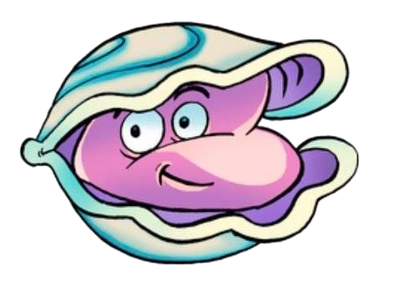
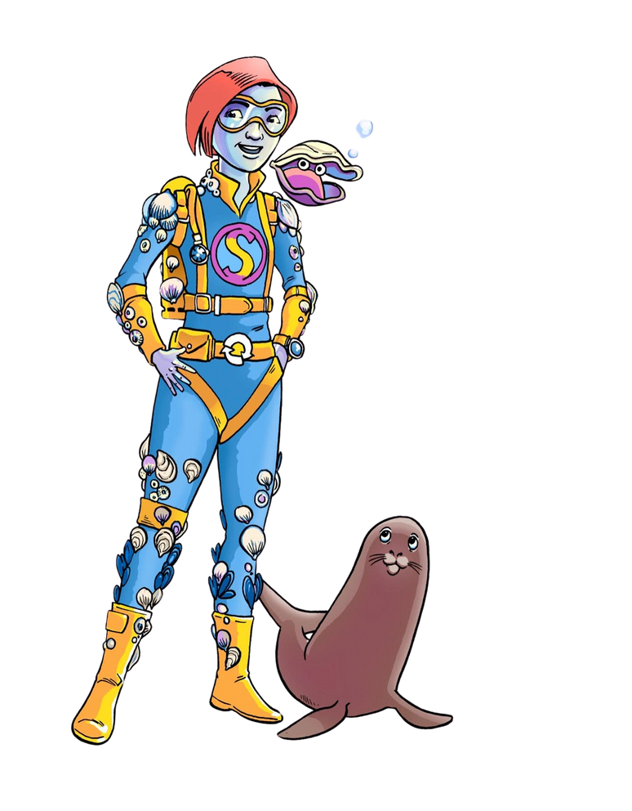
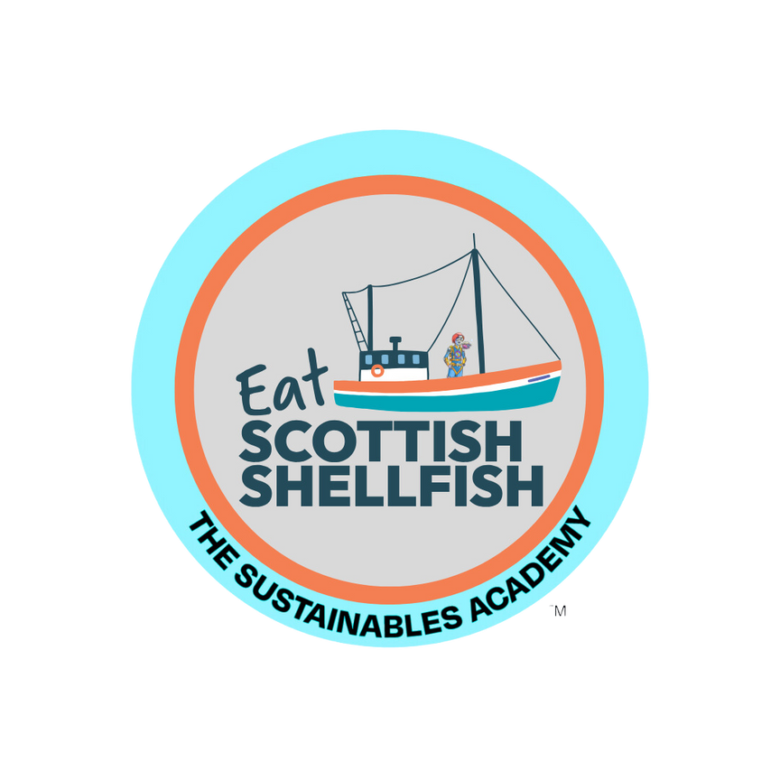
DESIGN
LEARNING

Slide 2
Marine Ecosystems and Conservation
Analyse the role of mussels and oysters in marine ecosystems:
Learners will explore how mussels and oysters help maintain healthy marine environments, including their role in water filtration and supporting biodiversity.
Discuss the importance of marine conservation:
Learners will recognise the threats to marine life and ecosystems,
including pollution and climate change, and identify ways
in which sustainable practices in aquaculture can contribute to
marine conservation.

Slide 3
NUTRITION AND HEALTHY EATING
Identify the nutritional benefits of mussels and oysters:
Learners will learn about the health benefits
of eating mussels and oysters, such as being a
source of protein, vitamins, and minerals,
and their role in a balanced diet.
Create a balanced meal plan that includes sustainable seafood:
Learners will incorporate mussels or oysters
into a meal plan, demonstrating an understanding
of healthy eating and sustainable food choices.

Slide 4
Sustainability and the Circular Economy
Describe the concept of a circular economy in seafood production:
Learners will explain how Scottish mussel and oyster
farming supports the circular economy by minimising
waste and reusing resources.
Evaluate the environmental impact of locally sourced versus imported seafood: Learners will compare the sustainability
of locally farmed mussels and oysters with that
of imported seafood, considering
carbon footprint, transportation, and resource use.

Slide 5
Social Responsibility and Stewardship
Develop ideas for responsible seafood consumption:
Learners will discuss how choosing sustainable
seafood can support the environment and benefit local communities.
Engage in a conservation activity:
Learners will participate in an activity that
emphasises their role as Earth stewards,
such as creating posters to raise
awareness about sustainable seafood
or marine conservation efforts.

Slide 6
Understanding Aquaculture and Marine Farming
Explain the basics of Scottish mussel and oyster farming:
Learners will describe the methods used in
Scottish mussel and oyster farming,
including how these practices contribute to
sustainable seafood production.
Identify key characteristics of sustainable aquaculture:
Learners will understand and explain
what makes mussel and oyster farming sustainable, such as low environmental impact, natural filtration, and minimal energy use.

