Slide 1



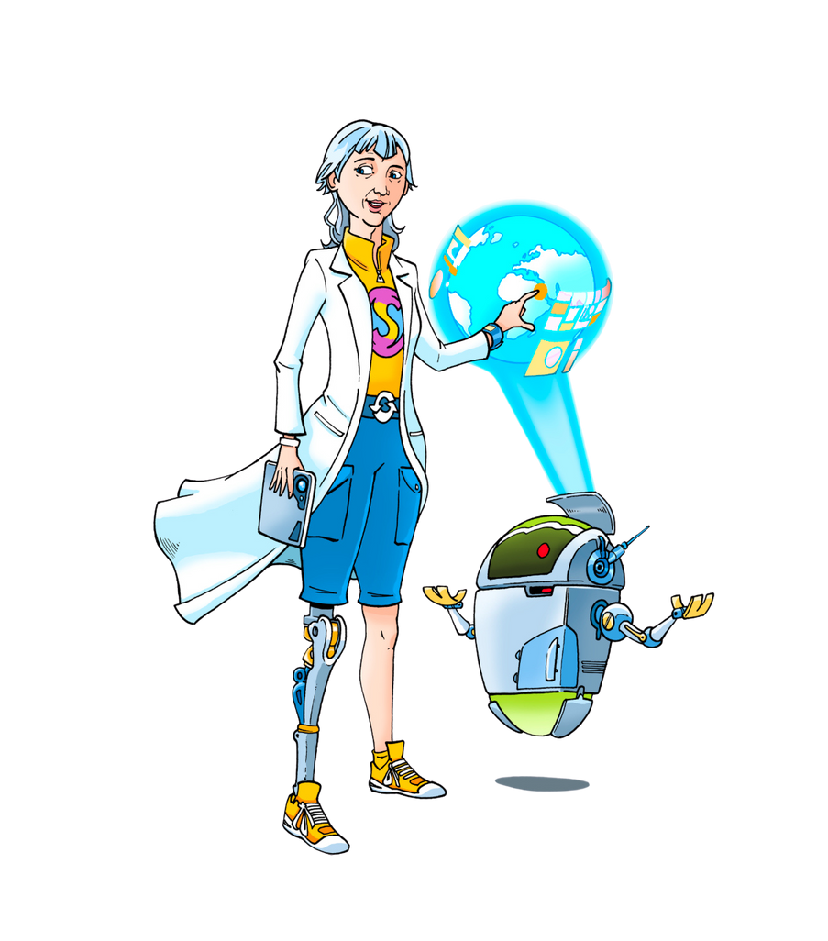
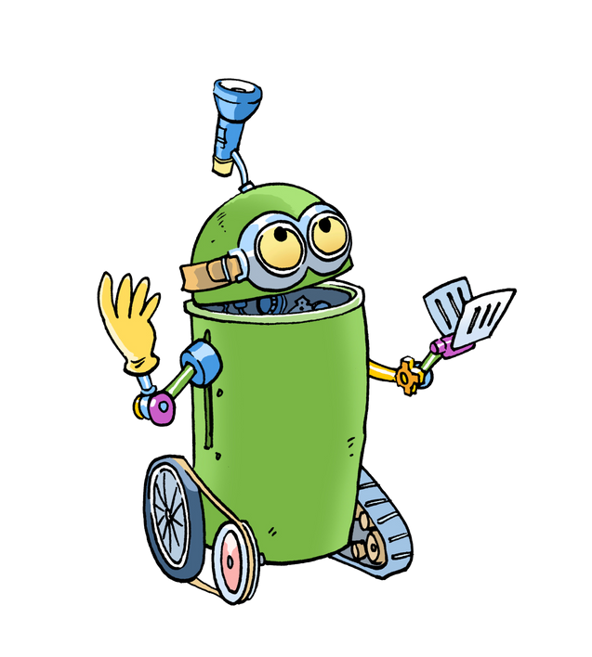
"Be a Leader in the
Resource Revolution Centre
Eco Waste Park Competition!"
Meet Systo
she will support you

Slide 2
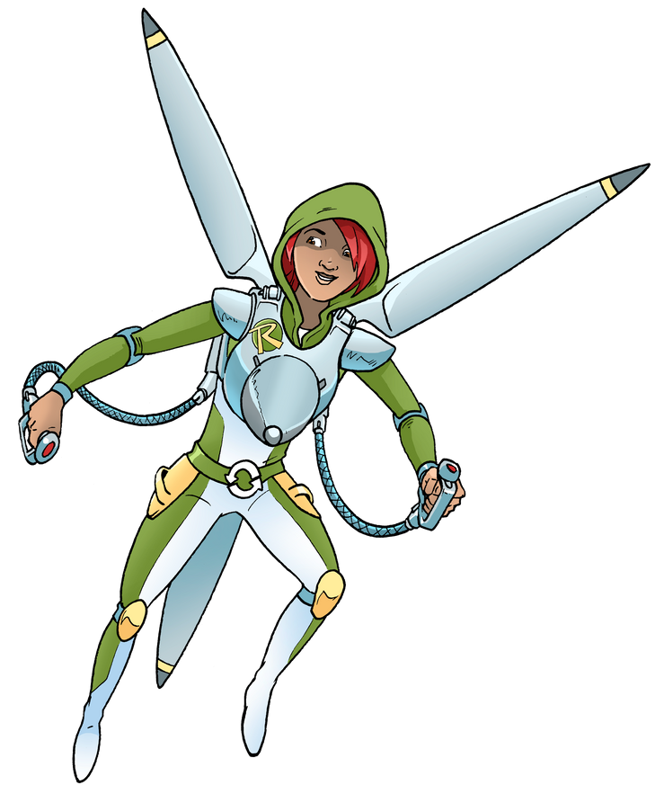
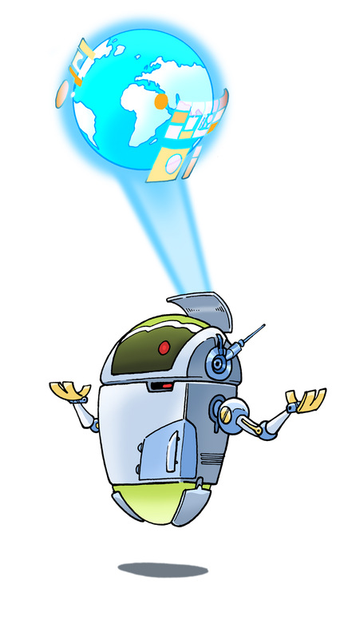
What Is the Resource Revolution?
The Resource Revolution is about solving Earth’s problems by reusing and recycling, creating a cleaner, greener planet.
and we need a
Resource Revolution centre
and we need leaders !
This competition lets you and your friends design an Eco Waste Park that shows how we can help Earth.
You need to find out about what the competition is asking you to do and the rules

Slide 3

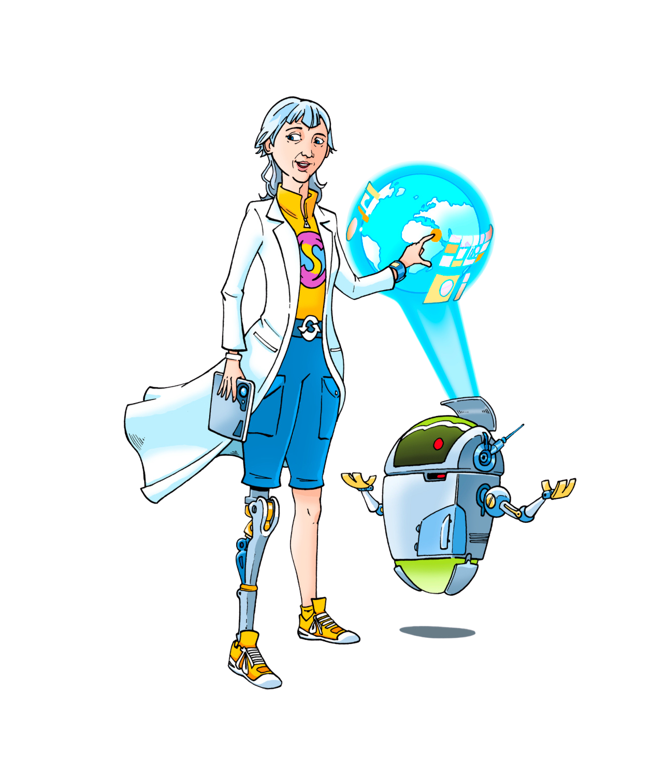
Why Become a Leader?
As leaders you will...
Inspire your friends
to be creative and make a difference.
You will need to tell them all about the
Resource Revolution Centre
Competition
Can you think of ways that you could Inspire your friends to take part in our competition?

Slide 4
Here are our ideas
As a leader, you :
Need to explain the competition
Encourage your friends to stay organised.
Encourage ideas and make sure everyone feels included.
Share your knowledge to help the team succeed.
You might like to make a plan ...

Slide 5
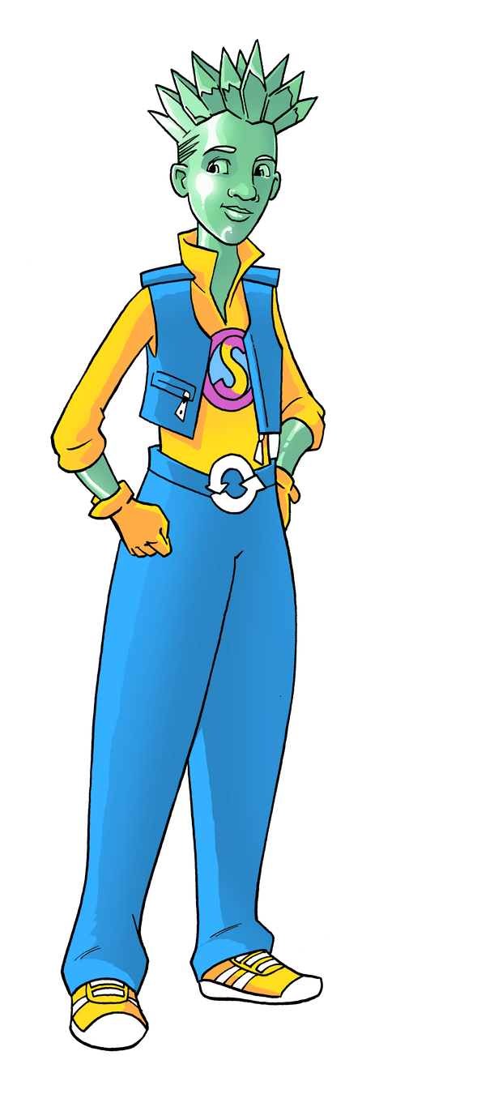
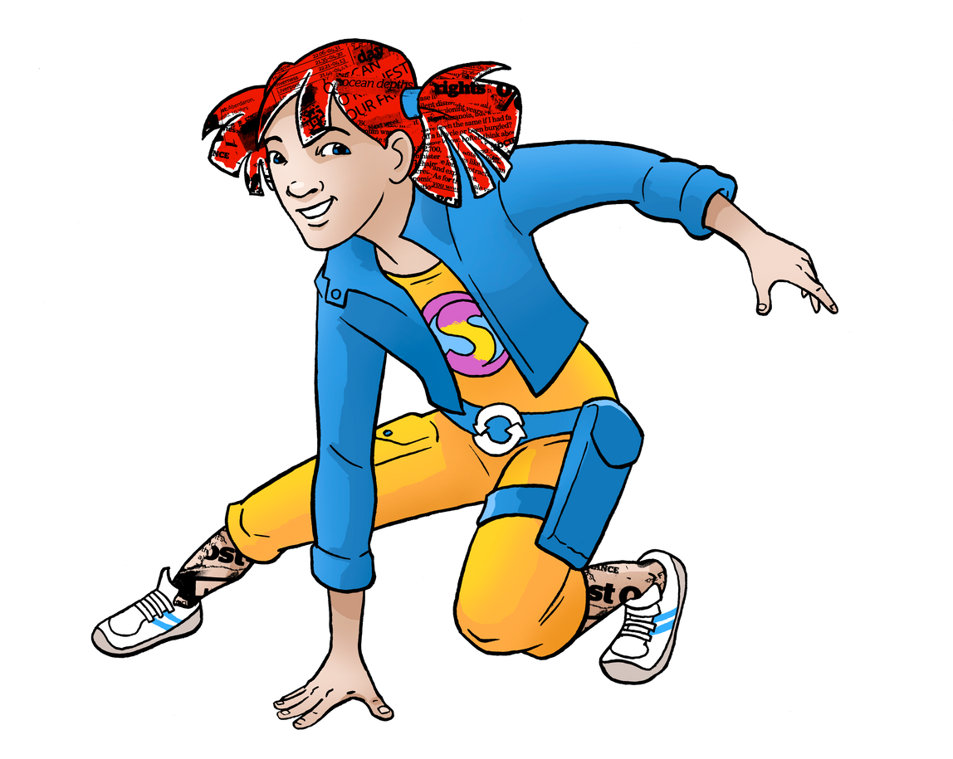
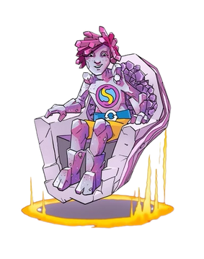
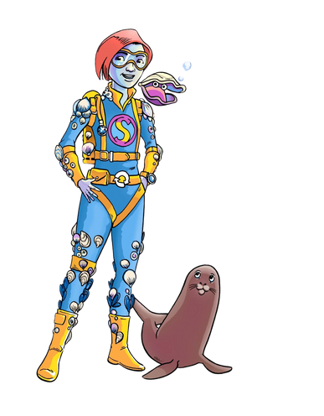
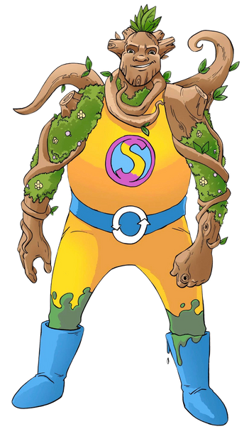
Encourage your friend to form teams
These are some of the roles they can take
You will need to explain this to them.
The Designer
Leads the park design and layout.
Makes it look creative and sustainable.
The Organiser
Keeps everyone on track.
Creates schedules and makes sure the team meets deadlines.
The Researcher
Finds cool facts about eco-parks and waste management.
Brings in new ideas for the team to use.
The Communicator
Shares the team’s ideas during presentations.
Makes sure everyone understands the plan.
The Earth Steward Leader
Focuses on using sustainable materials and eco-friendly ideas.
Teaches the team about recycling and reusing.

Slide 6
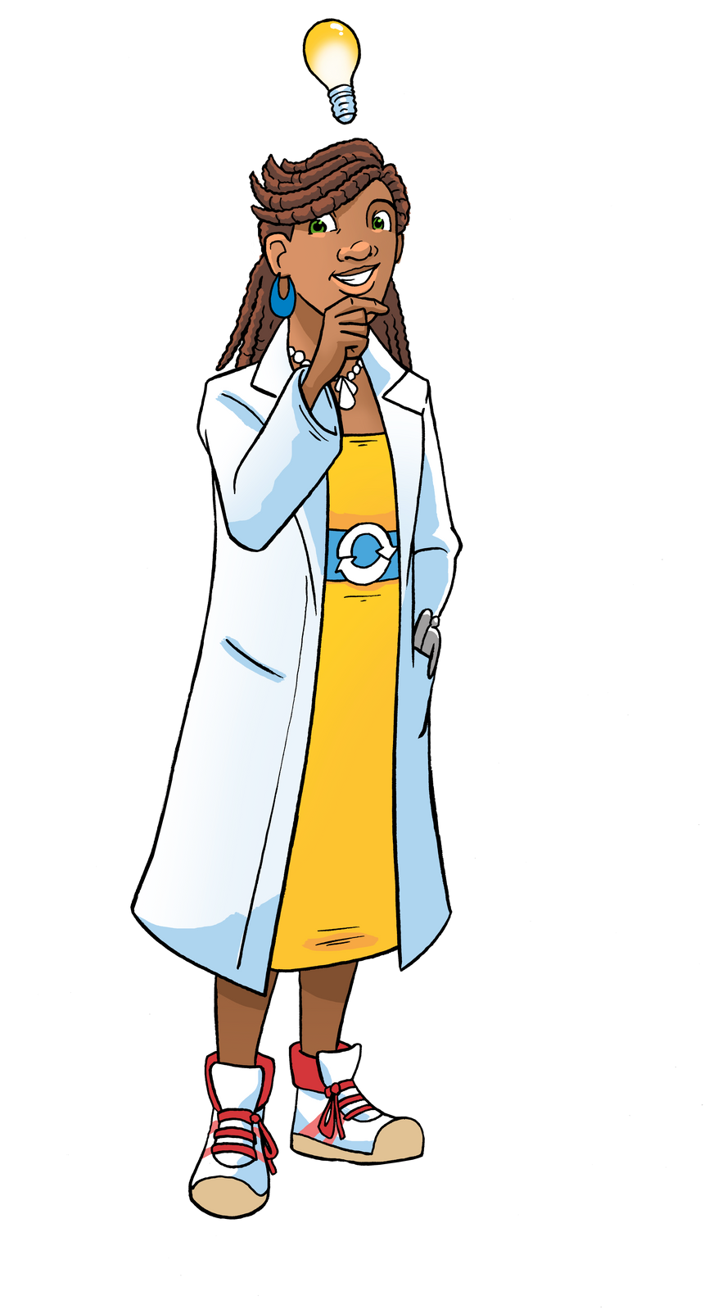
How to Encourage Teams
Explain that they need to...
Listen to everyone’s ideas – no idea is too small!
Be positive and help solve problems.
Remind your team of the goal: a creative, eco-friendly Waste park called the Resource Revolution Centre!
Share what you learn with your friends.

Slide 7
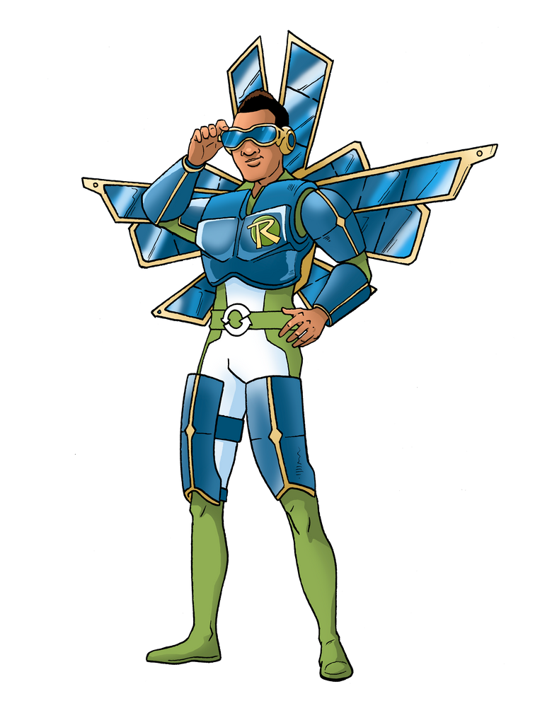
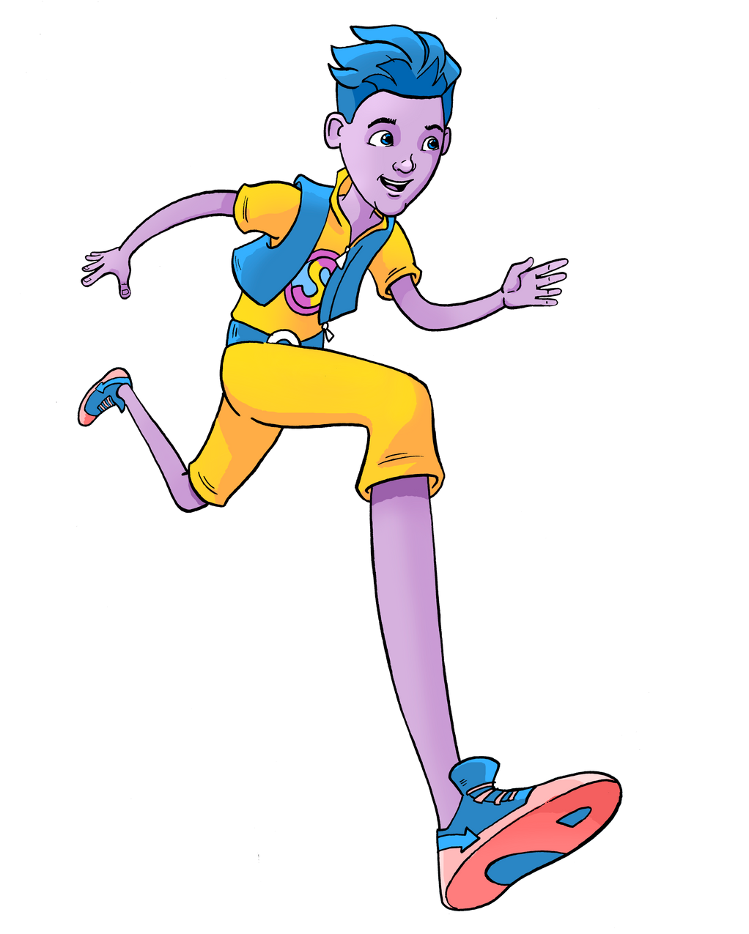
Ideas to Inspire Your friends by explaining some of the tasks that need to be developed at The Resource Revolution Centre
Recycle everyday items like bottles and tyres for park structures.
Include zones for learning, fun, and relaxation.
Add renewable energy ideas like solar lights.
Create a waste-sorting station in the park.
Create areas when new things are made
Think about the 10Rs
Think of ways to make the park look green and welcoming.

Slide 8
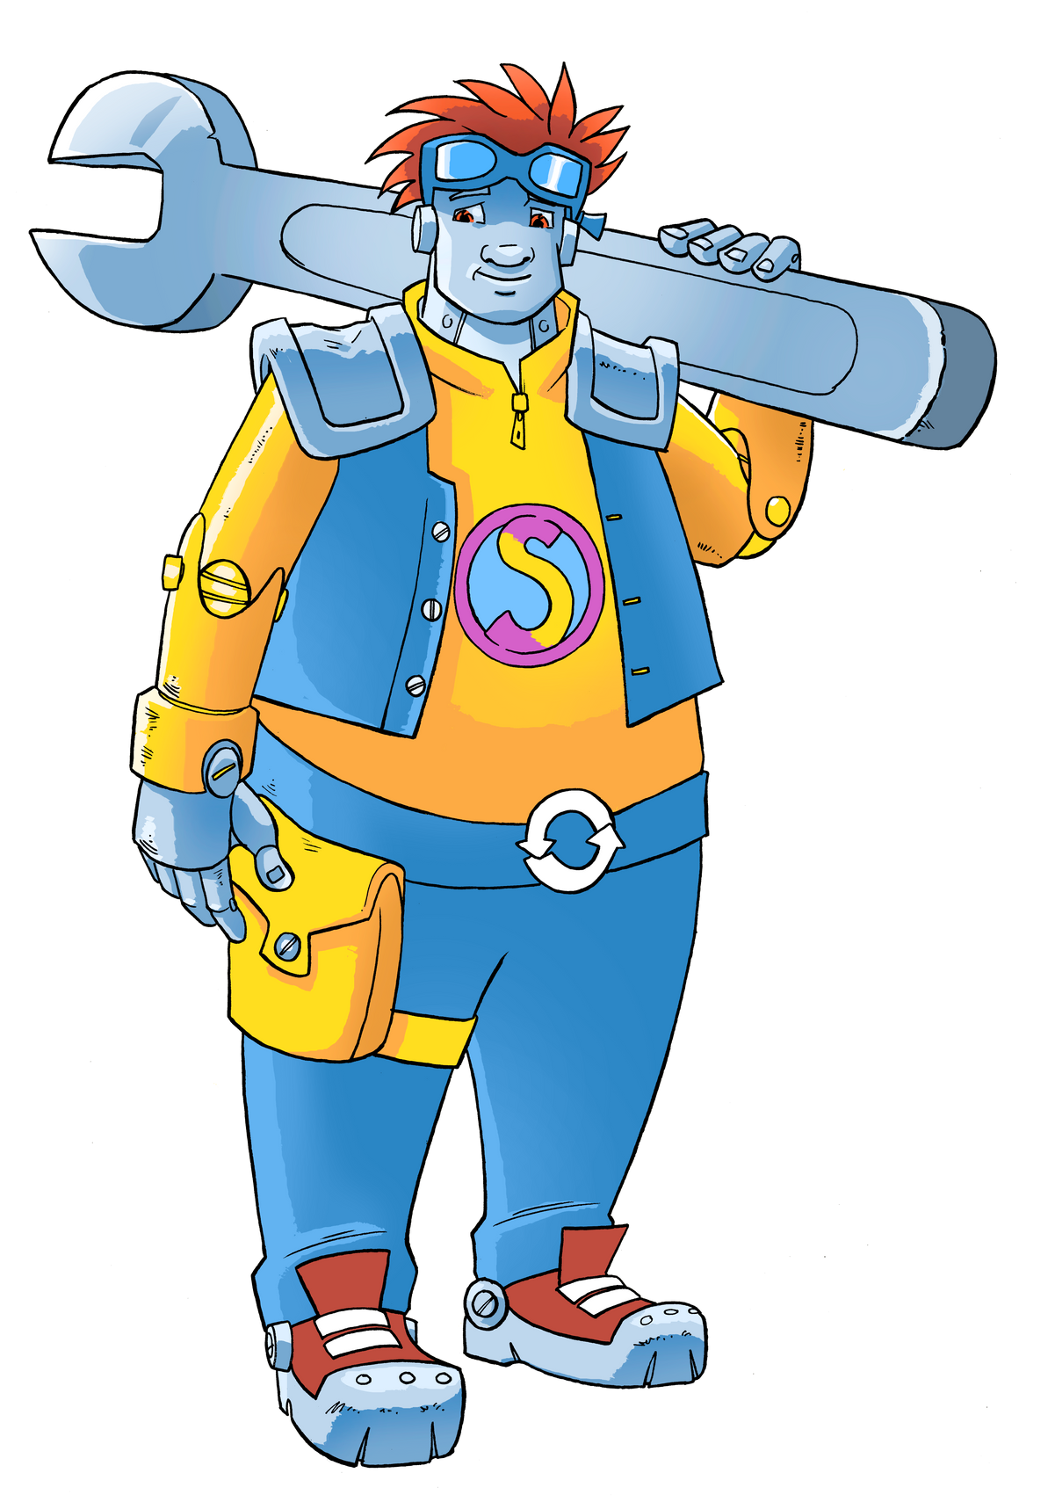
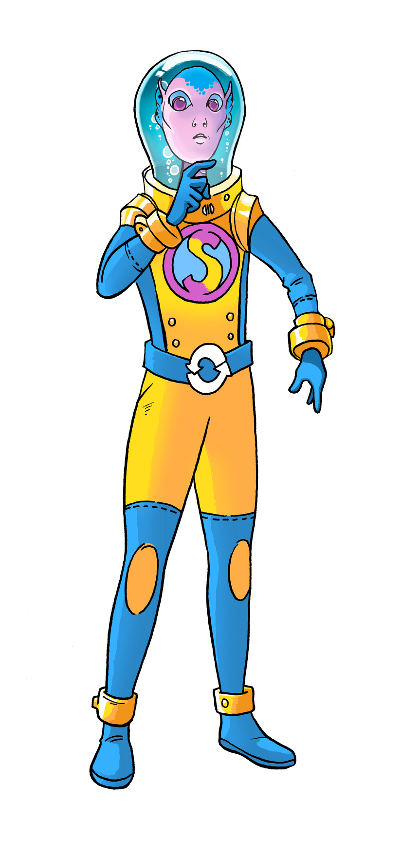
Fun Ways to Lead the project
Organise brainstorming games.
Set mini-challenges like “Best Recycled Material Idea.”
Celebrate small wins as a team.
Use creative tools like posters or digital drawings to bring ideas to life.

Slide 9
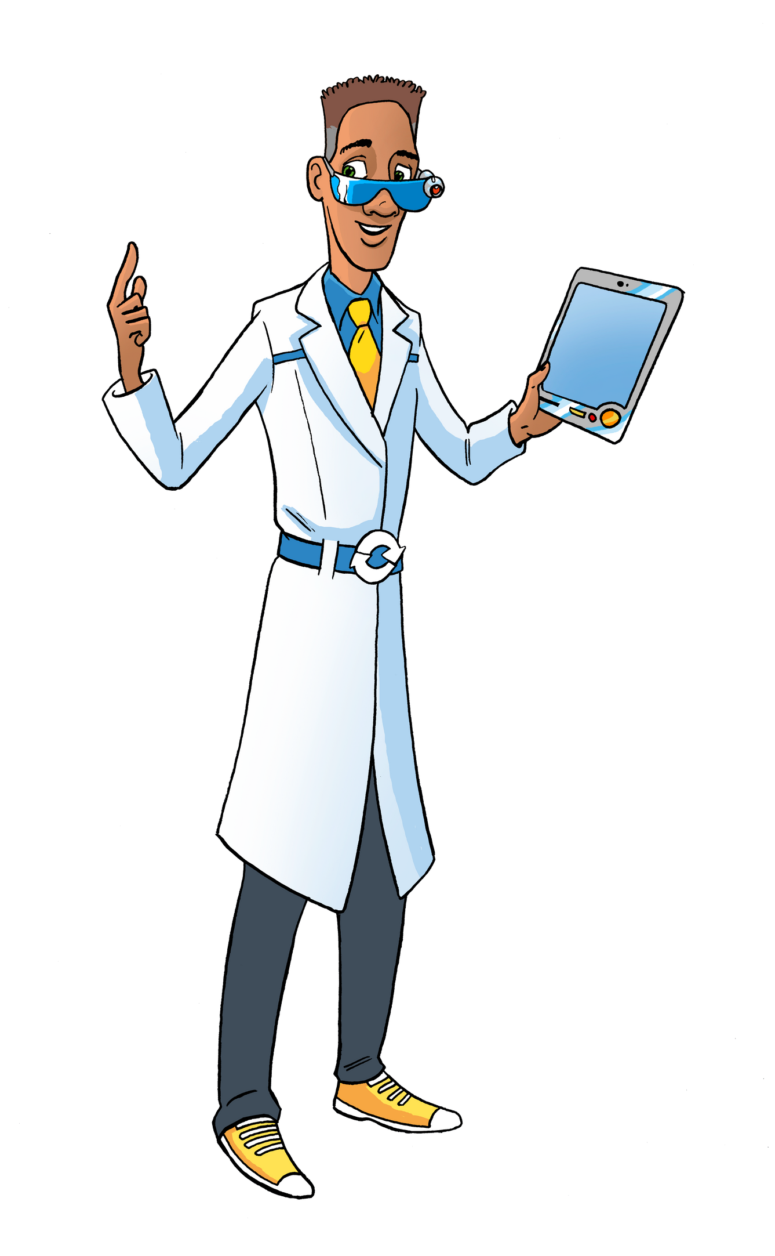
Remember: You Are a Change maker!
and you are supporting your school , class and individuals
By leading,
you’re helping the Earth and showing others how they can too.
Every great idea starts
with someone brave enough to lead!

Slide 10
Get Started Now!
Decide on your leader roles.
Use tools such as a Mind map
Gather your team and
share what you’ve learned.
Make a presentation
Start brain buzz talking how you
can get your friends and school involved
Make a plan decide on what (you
as leaders ) are going to do share this project
Thank you
A checklist with "Roles, Ideas, Plan!"
for instance
An Assembly
Updates

