Slide 1

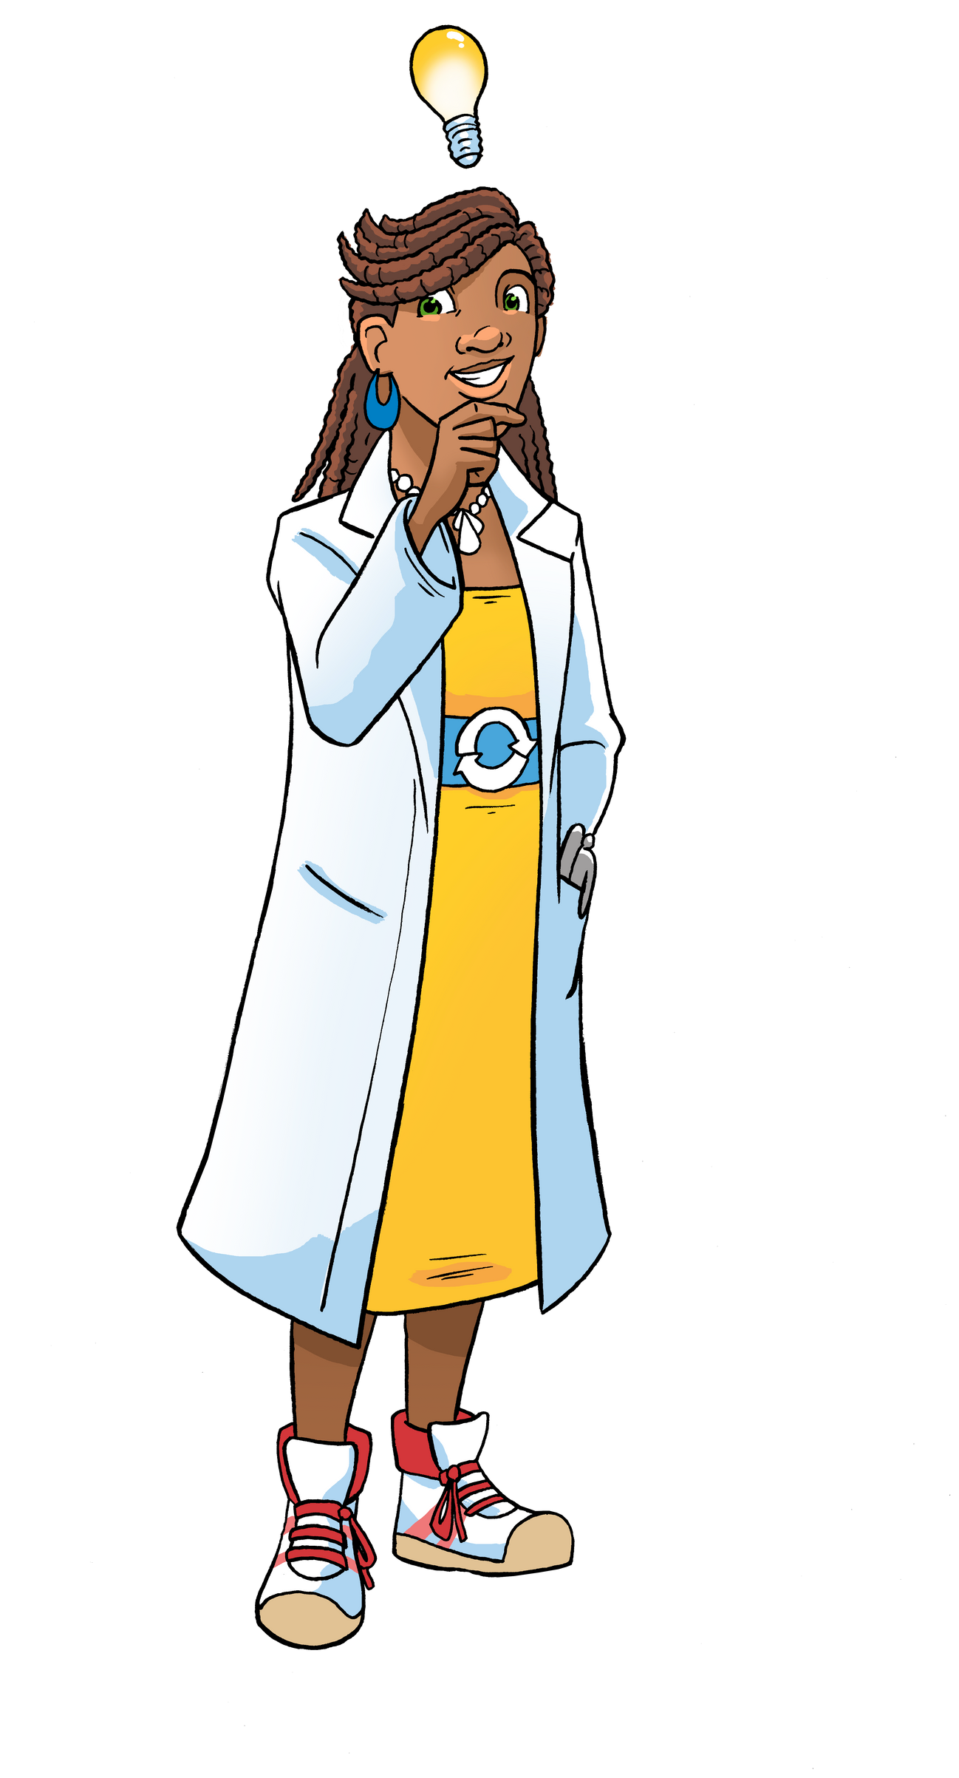

Embedding The Sustainables Into Your Curriculum
May27th 2025
Intro to The Sustainables

Slide 2
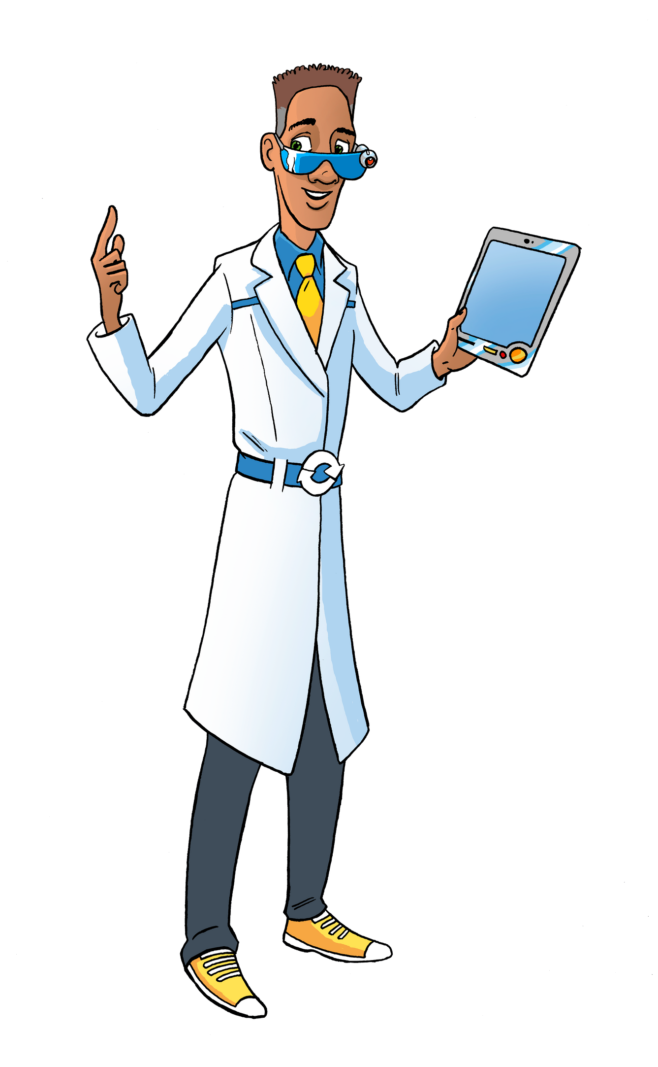
By the end of this session, participants will:
  Understand The Sustainables resources.
  Know how to embed sustainability and the circular economy into the curriculum.
  Explore connections with other key frameworks like the UNCRC, Eco-Schools, and SDGs.
  Be familiar with community involvement opportunities, including the Duke of Edinburgh Award (DofE) and local clubs.
Real Example: Explore books such as "The Lorax" by Dr. Seuss, where sustainability and environmental responsibility are central themes. This can kick off a classroom conversation about the importance of sustainability and Earth stewardship, sparking curiosity for how to integrate sustainability into their daily life.

Slide 3
Phenomenon Question:
"What would happen if every school around the world adopted sustainable practices in their everyday activities?"

Slide 4
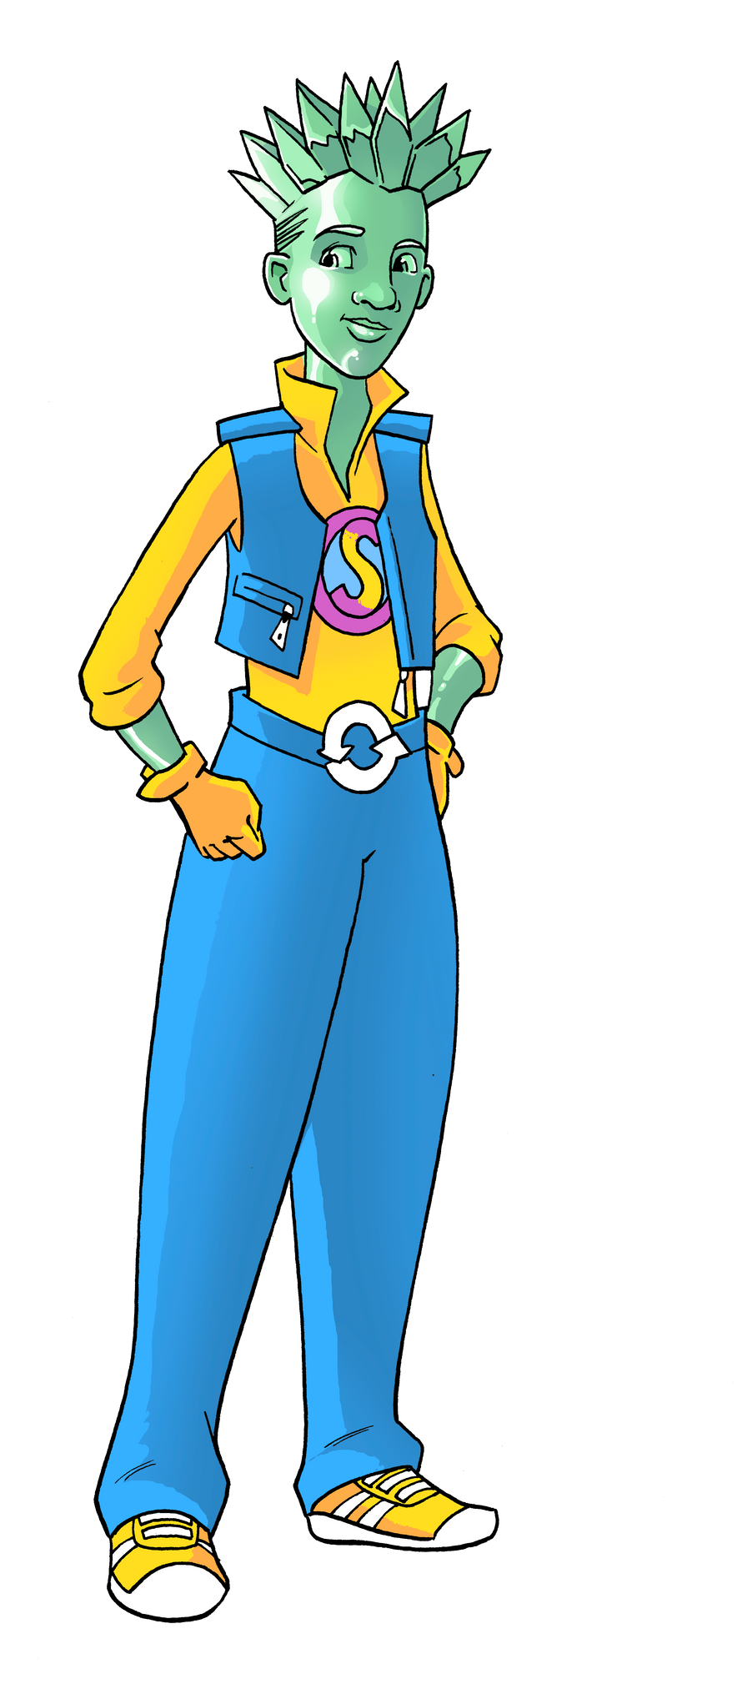
Introduction to The Sustainables Academy
- A Not-for-Profit Free Resource for Education
Focus: Sustainability, Climate Mental Health, and Circular Economy Curriculum.
Core Principles
  Earth Resources and Earth Stewardship at the heart of learning.
  Three Pillars of Sustainability: Environmental, Social, and Economic.
  A holistic approach to integrating sustainability across subjects.
  Real Example: Incorporate "The Water Princess" by Susan Verde, which addresses water conservation. This could be part of an outdoor classroom activity where children measure water usage in the school (e.g., water fountains, hand washing stations), and then create solutions to reduce consumption.
  Inside Classroom: Students could map out how water moves through the school, identifying where they can save water.
  Outside Classroom: Plan a water conservation campaign around school grounds or with the local community.

Slide 5

Phenomenon Question:
"How could we use Earth’s resources
in a way that helps the planet
and all living things thrive?"

Slide 6
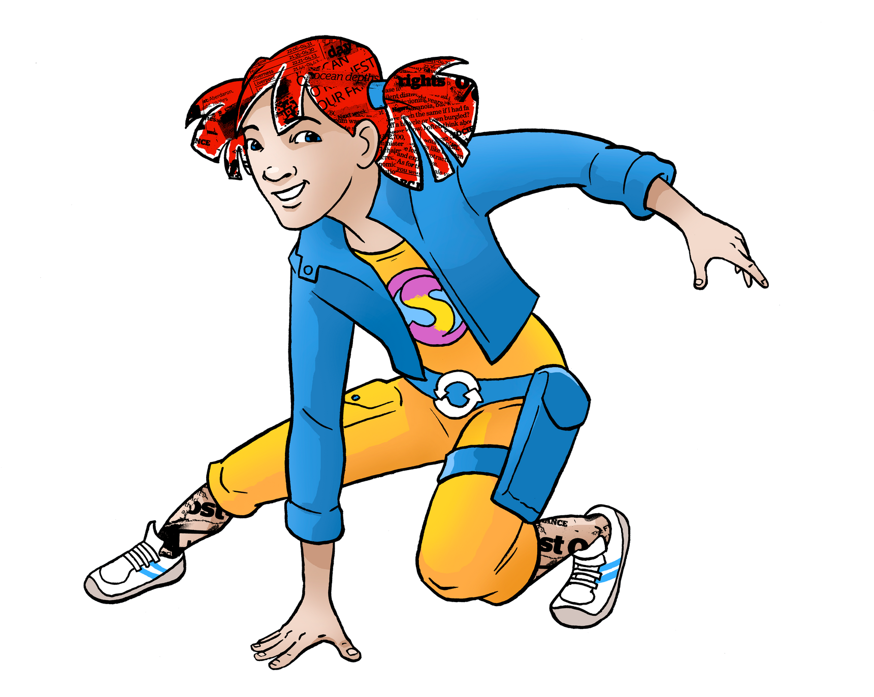
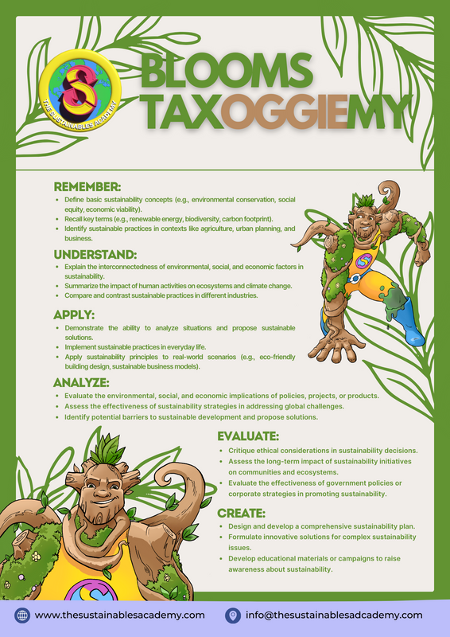
Professional Support
- Academic Resources and Pedagogical Approach
  Resources:
Access academic resource pages on our website.
Books, journals, and peer-reviewed articles supporting learning.
  Pedagogy:
Engages with critical learning theories:
Vygotsky (social constructivism)
Bloom’s Taxonomy (higher-order thinking)
Bruner (discovery learning)
Encourages independent, student-led learning.
www.thesustainablesacademy.org]
  Real Example: Link "The Story of Stuff" by Annie Leonard (book or video) to Vygotsky’s theory. The video explains the life cycle of products and consumption, which is a perfect entry into discussing the circular economy.
  Inside Classroom: Create student-led groups that explore the lifecycle of different products like plastic bottles, clothes, or food, and present their findings using Bloom’s Taxonomy (e.g., analyzing product impacts and proposing circular alternatives).
  Outside Classroom: Invite local experts or community leaders to speak about circular economy practices, which could be part of a project on reducing school waste.

Slide 7
Phenomenon Question:
"How can the way we learn about
the environment change the way we act towards it?"

Slide 8
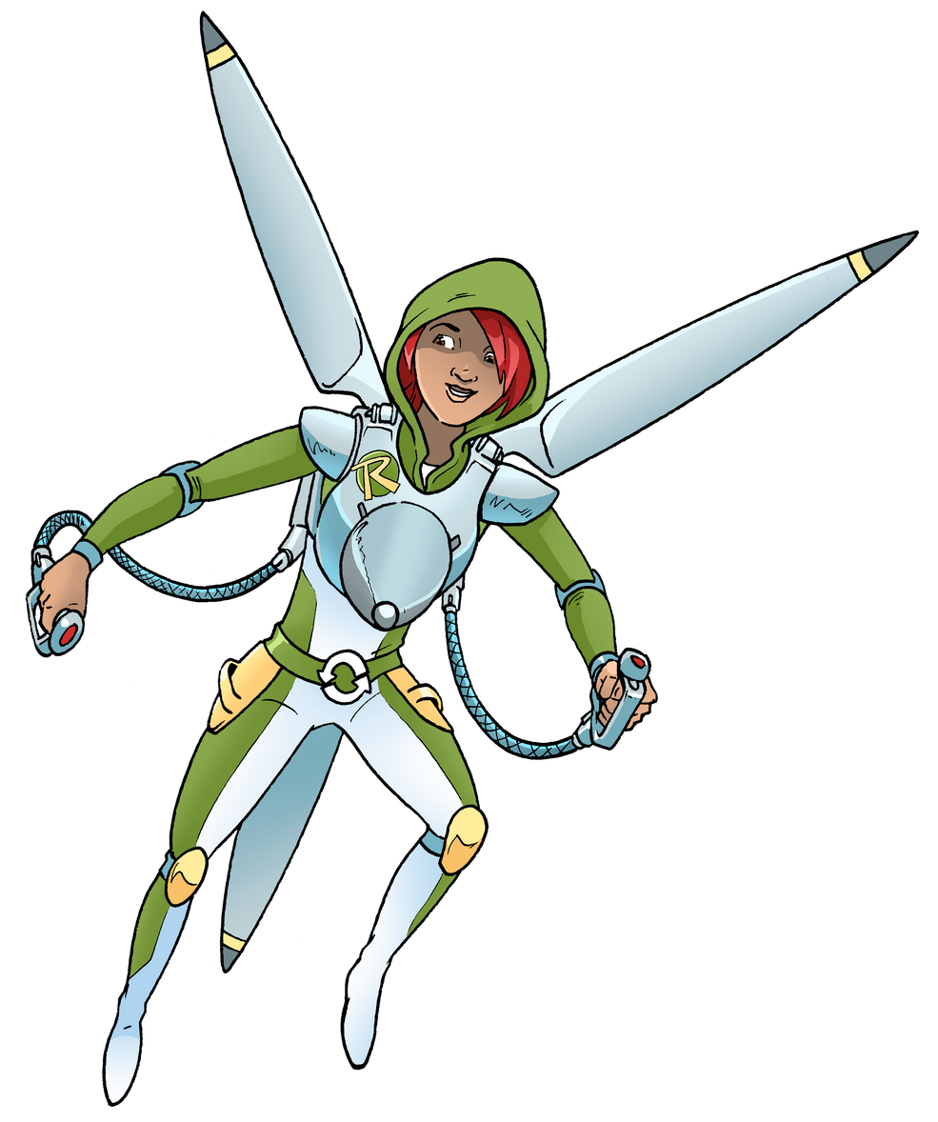
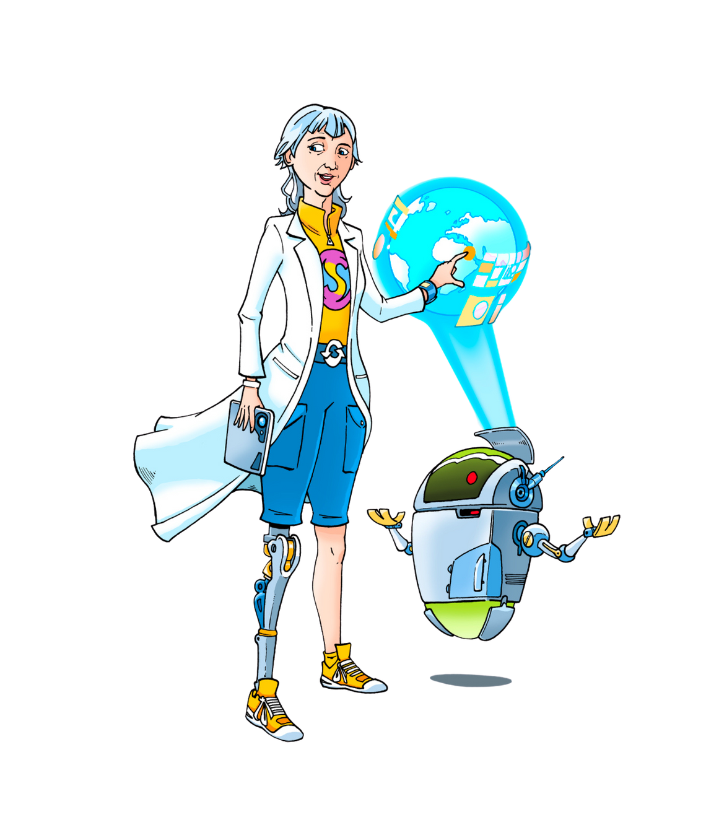
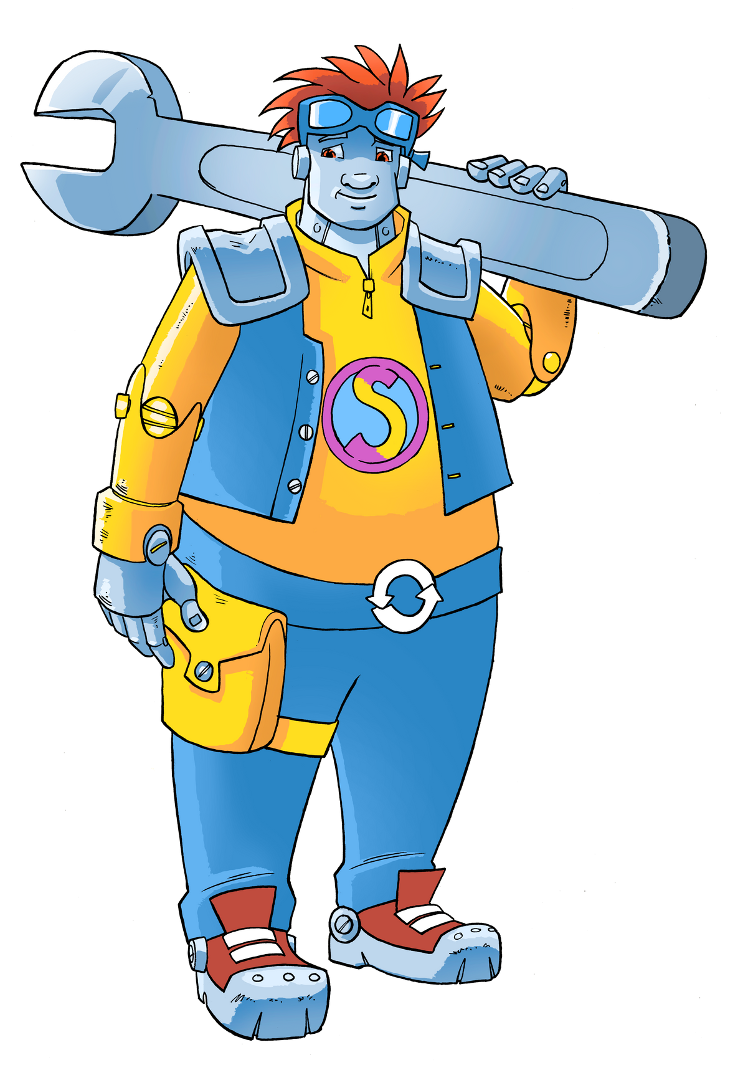
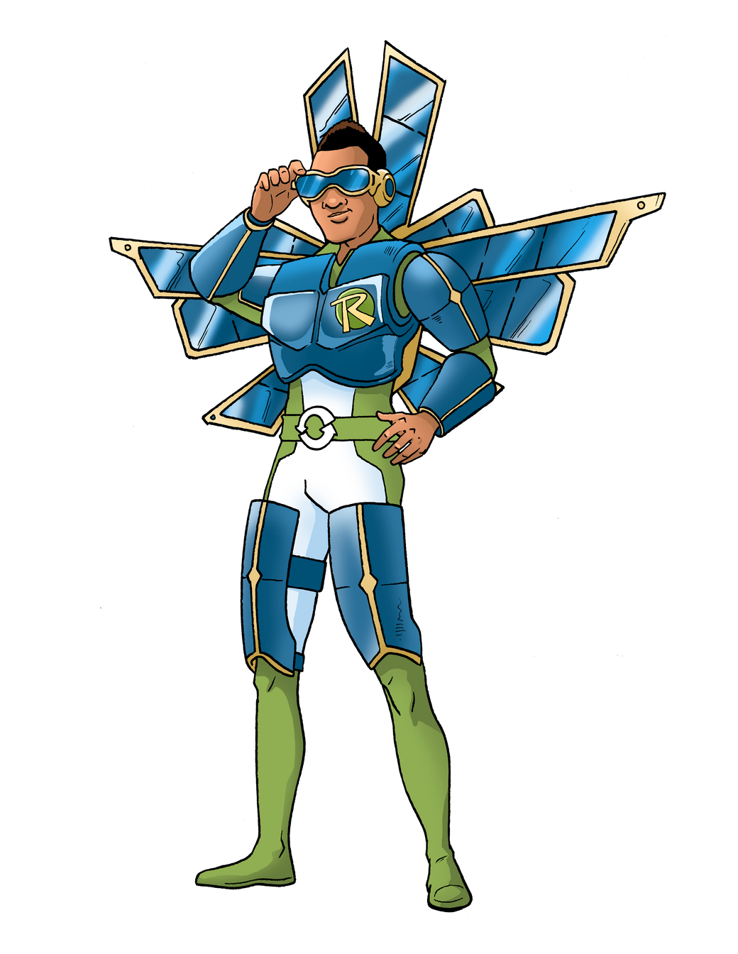
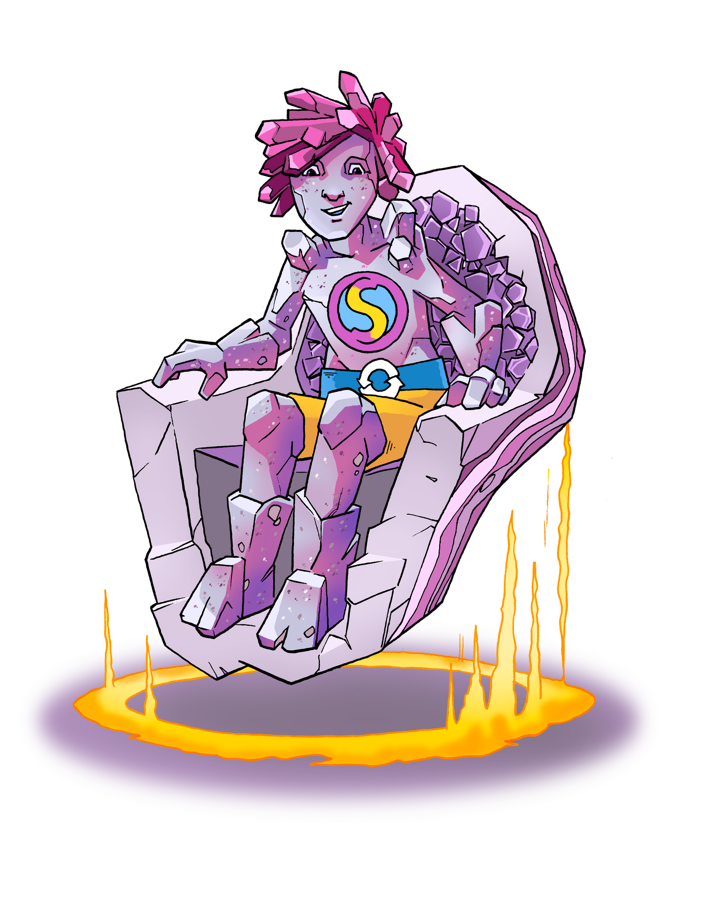
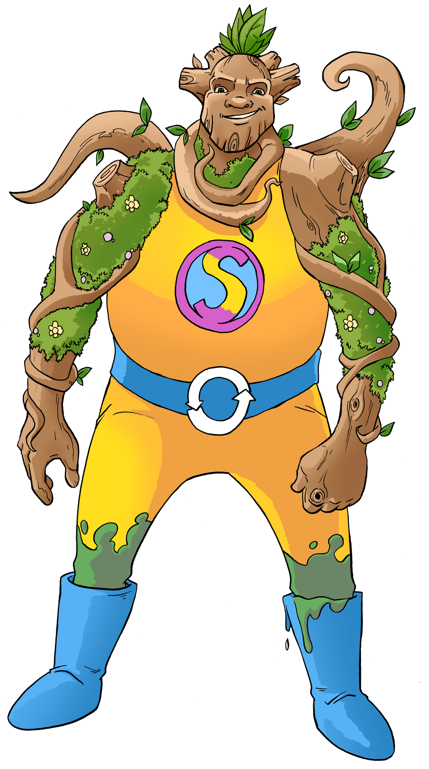
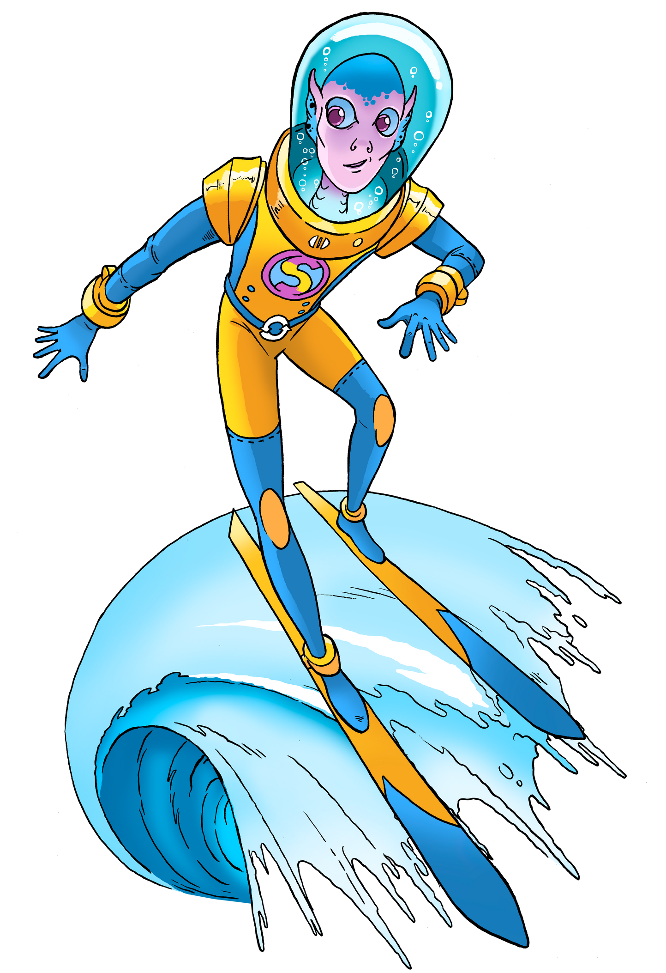
Characters at the Forefront
Inclusive Design:
Diverse abilities, races, and non-gendered designs.
Personification of Earth resources.
Role of Characters:
Help identify learners’ roles and motivations.
Ideal for use in house teams, displays, and learning environments.
Provide a relatable entry point for all learners.

Slide 9

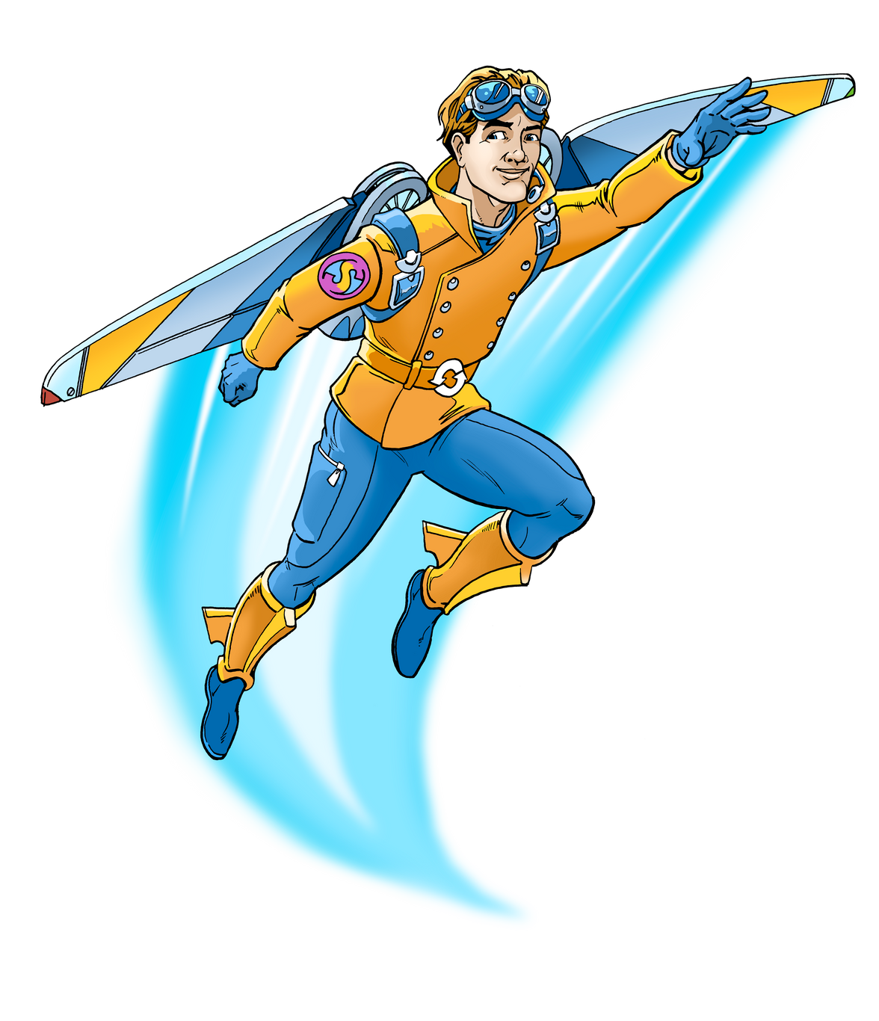
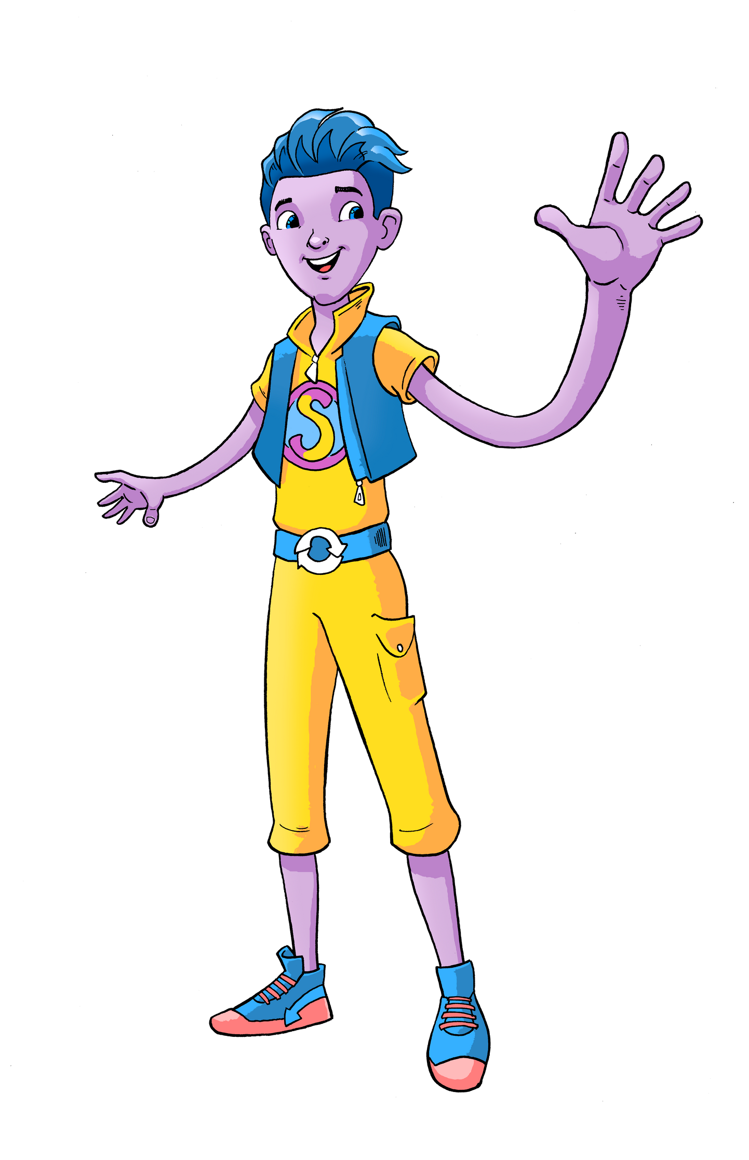
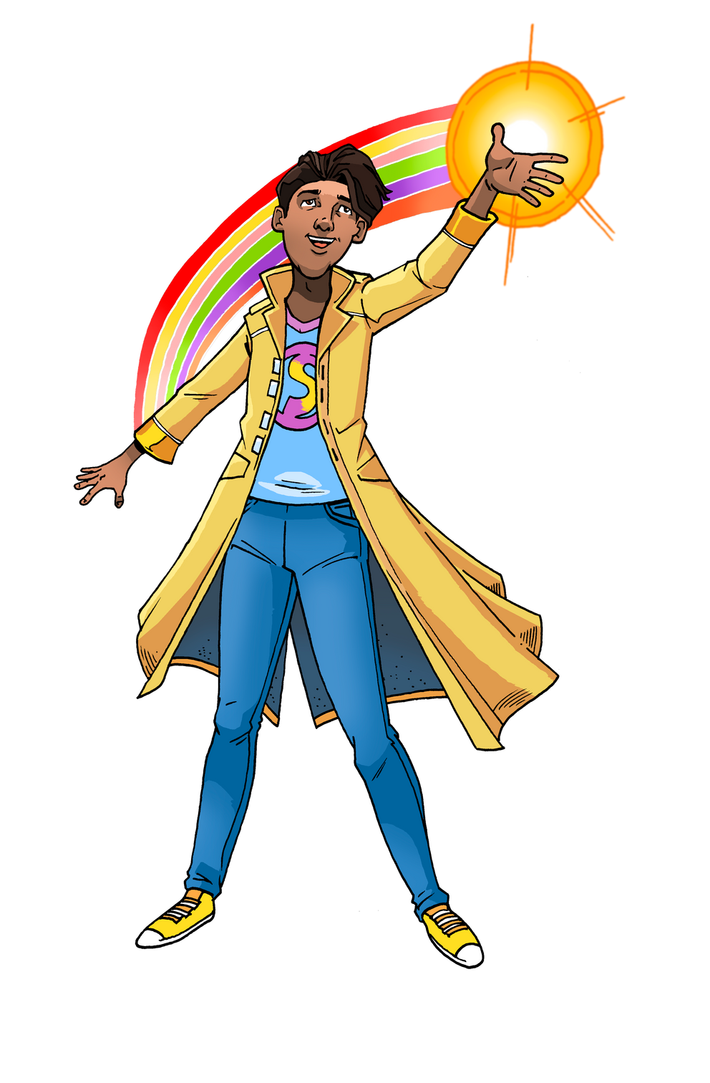
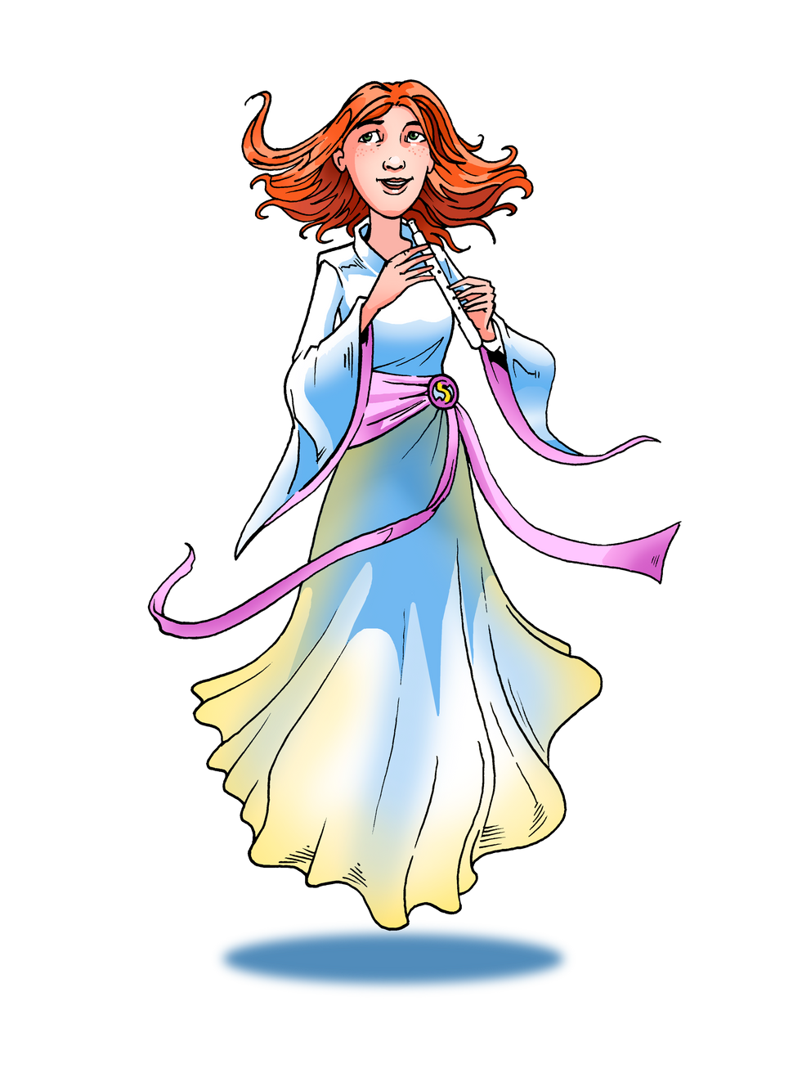
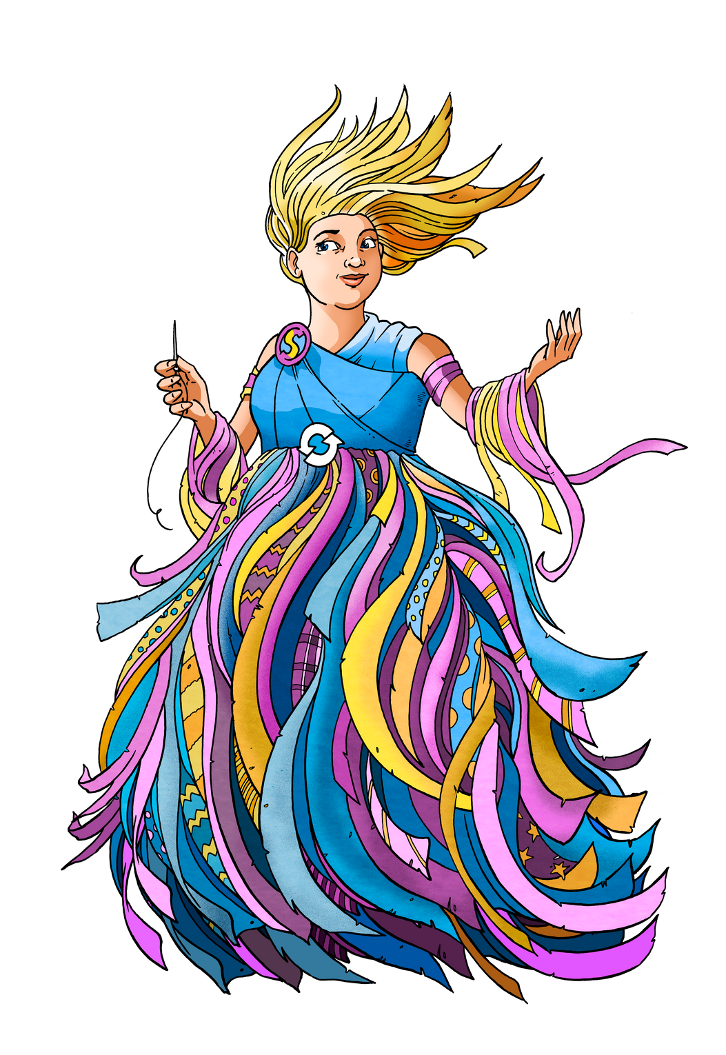
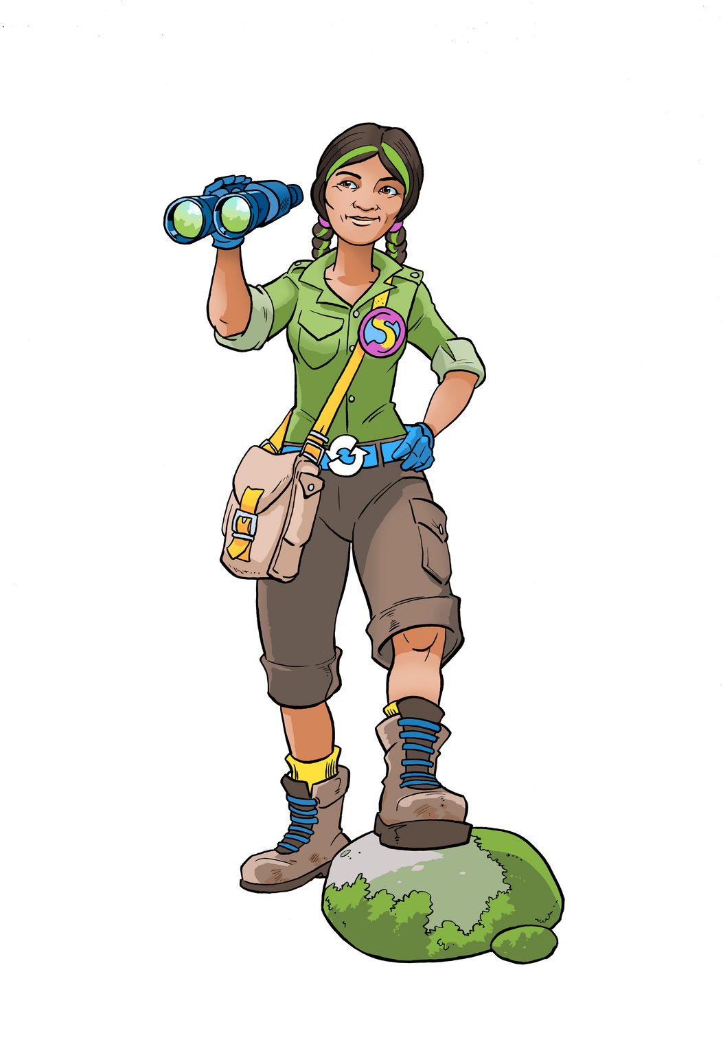
House Teams / Class Mascots
Real Example:
Introduce characters like Aqua (water conservation) from The Sustainables Academy.
Inside Classroom:
Use Aqua as a character to teach about the water cycle, focusing on how water is reused in nature and how humans impact this process. Students could role-play Aqua as an advocate for clean water.
Outside Classroom:
Have students take part in an environmental cleanup day, using Aqua as a mascot for their efforts in reducing water pollution.

Slide 10
Phenomenon Question:
"If we could be Earth Stewards
like Aqua, what changes
could we make at school
to conserve water?"

Slide 11
Meet the Teams
The Achievables:
Scientists and conservationists leading environmental change.
The Flourishables:
Experts in climate mental health, empowering positive mindsets.
The Sustainables:
    Earth Stewards guiding earth resources management and stewardship.
The Wasters:
Subconscious figures who challenge bad practices and behaviours.
These teams are designed to encourage growth and foster responsibility.
Real Example: Introduce "The Great Kapok Tree" by Lynne Cherry, where environmental conservationists (The Achievables) are featured protecting the rainforest.
Inside Classroom: Learners can role-play as The Achievables, conducting "field research" on local environmental issues (e.g., local deforestation or wildlife conservation).
Outside Classroom: Organise a visit to a local park or nature reserve for an eco-tour led by local conservationists, where students can apply their learning about ecosystems.

Slide 12
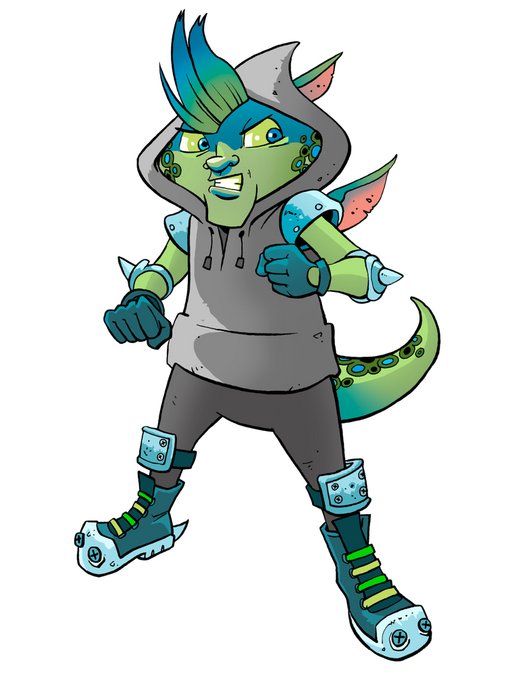
Phenomenon Question:
"What can we learn from
the different teams
(The Achievables,
The Flourishables,
The Sustainables,
The Wasters)
about how to protect our world?"

Slide 13

Sustainability and the Balance of the Biosphere
The Challenge:
Over the years, good intentions (e.g., solar panels, cotton) have sometimes overlooked the broader environmental
impacts.
Example: Cotton water usage, plastic pollution, end-of-life management.
Key Message:
  We must embrace balance and take responsibility for our actions.
  Plastics /Polymers will always be present, but their management can be improved.
  Focus on solutions like mono-materials in packaging for better recycling.
  Real Example: Use "One Plastic Bag: Isatou Ceesay and the Recycling Women of the Gambia" by Miranda Paul to demonstrate the impacts of plastic pollution and solutions.
  Inside Classroom: Organize a discussion around the impact of plastic on ecosystems. Have students design their own recycling systems and explore how their community could reduce plastic waste.
  Outside Classroom: Conduct a plastic collection campaign in the school or community, emphasising recycling through mono-material packaging.

Slide 14
Phenomenon Question:
"What happens when
we use something
that is good for the environment
but doesn't have the full impact
we expected,
like using solar power
without thinking
about production waste?"

Slide 15
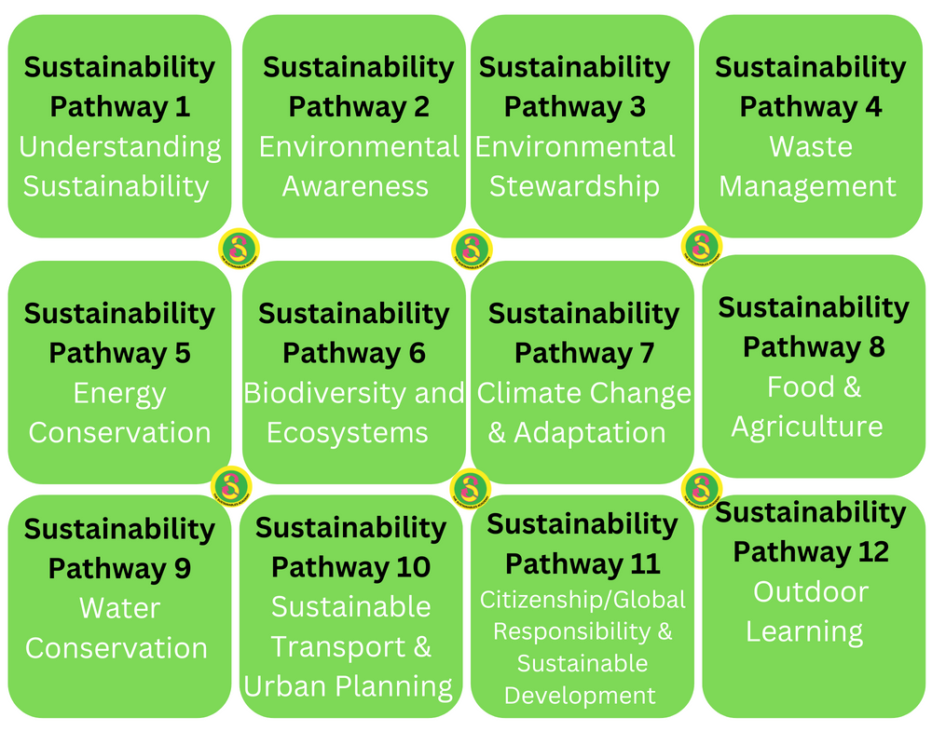
Sustainability Curriculum Pathways
- 12 Pathways for Sustainability
  Pathways Overview:
    Earth Stewardship
    Ecosystem Diversity
    Climate Change and Adaptation
    Water Conservation
    Renewable Energy
    Outdoor Learning & Nature Connectivity
  Implementation:
    Incorporate sustainability into every lesson, or focus
    on specific pathways.
    Supports cross-curricular connections.

Slide 16
Phenomenon Question:
"How can we use the
12 pathways of
sustainability to
create a school
that works in harmony
with nature?"

Slide 17
Sustainability Curriculum Pathways
- 12 Pathways for Sustainability
Real Example: Introduce the book "The Wild Robot" by Peter Brown, where themes of biodiversity, conservation, and technology intersect.
Inside Classroom: Students could research local endangered species or ecosystems and design conservation plans (linked to "Ecosystem Diversity" and "Climate Change and Adaptation").
Outside Classroom: Set up an outdoor "biodiversity survey" of the school grounds, cataloging plant and animal life

Slide 18
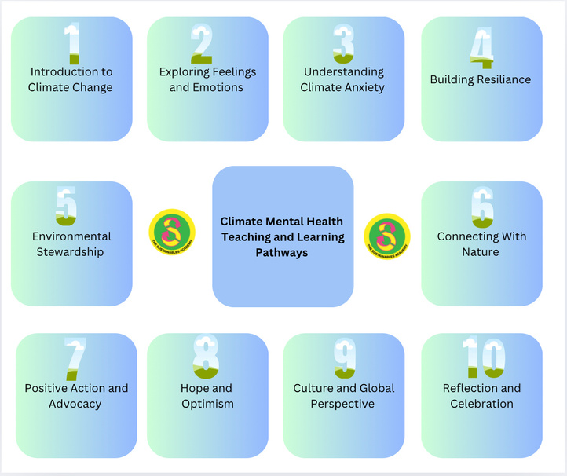
Climate Mental Health Pathways
- Supporting Wellbeing through Sustainability
12 Pathways for Climate Mental Health:
Empower learners with tools to manage climate anxiety and stress.
Emphasise empowerment through knowledge and action.
Goal:
Equip learners with resilience in the face of climate challenges.

Slide 19

Climate Mental Health Pathways
- Supporting Wellbeing through Sustainability
Real Example: Use "Malala's Magic Pencil" by Malala Yousafzai to explore how children around the world are tackling climate-related challenges.
Inside Classroom: Guide students in creating a "Climate Action Journal," where they document their feelings about climate change, action plans, and reflections on environmental justice.
Outside Classroom: Host a climate action day where students create posters, organize a community discussion, or share solutions with their school’s administration.

Slide 20
Phenomenon Question:
"How do our feelings
about climate change
affect the way we act,
and how can we stay hopeful
while taking action?"

Slide 21
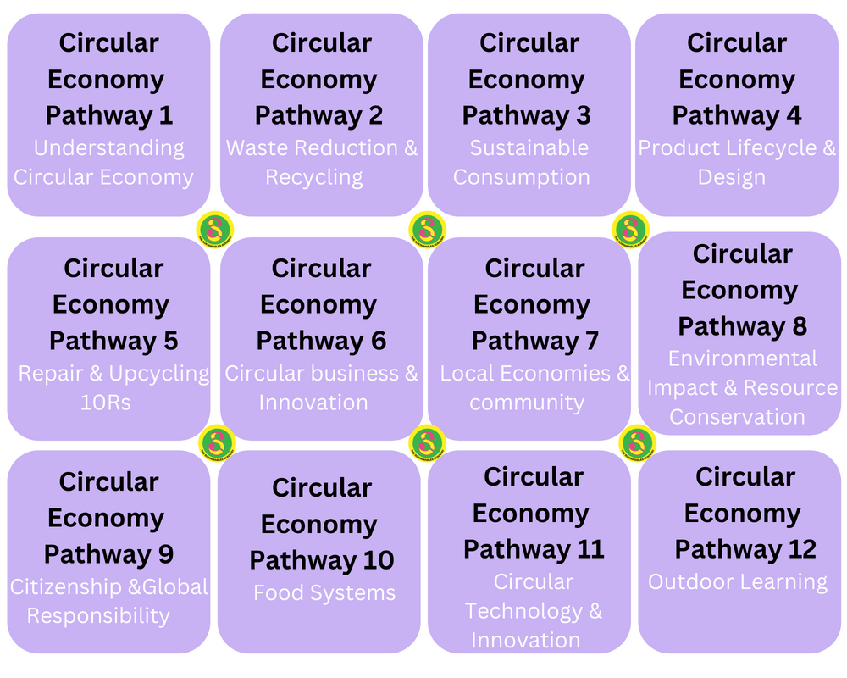
Circular Economy Curriculum
- Circular Economy in Practice
  12 Pathways in Circular Economy:
    Focus on real-world applications and the economy's transition to circularity.
    Key Topics:
    Mono-material packaging for recyclability.
    Challenges of mixed materials (e.g., lycra leggings with embedded polyester).
    Promote good recycling practices with clear, actionable examples.
    Advocacy:
    Encourage responsibility beyond just reuse and recycling.

Slide 22
Circular Economy Curriculum
- Circular Economy in Practice
Real Example: Use "The Curious Garden" by Peter Brown to explain the benefits of transforming abandoned urban spaces into green areas, an example of urban sustainability.
Inside Classroom: Students could design their own "urban garden" plan, where they think about reusing and recycling resources to make sustainable spaces.
Outside Classroom: Encourage students to plant a garden on school grounds using recycled materials for containers.

Slide 23
Phenomenon Question:
"How could we
redesign the things
we use every day to
make sure they don’t harm
the planet but are reused,
repaired, or recycled?"

Slide 24
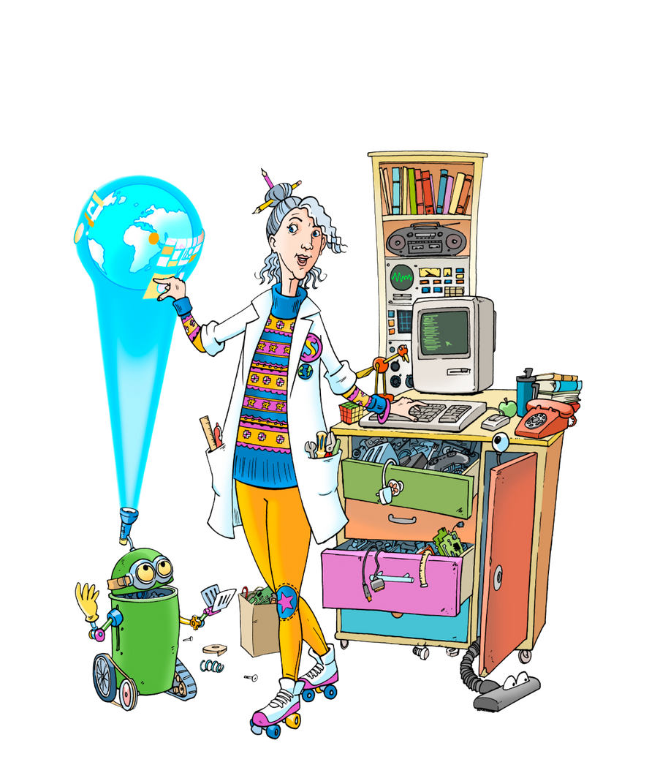

The 10Rs Philosophy
Rethink, Reuse, Recycle – And More
The Full Spectrum of 10Rs:
    Rethink
    Refuse
    Reduce
    Repair
    Reuse
    Recycle
    Reimagine
    Repurpose
    Regenerate
    Return
  Goal:
    Promote deep behavioural changes that go beyond recycling to holistic responsibility for our planet’s resources.
  Real Example: Integrate "The Adventures of a Plastic Bottle" by Alison Inches, which teaches about recycling and reusing resources.
  Inside Classroom: Students could create a series of projects based on the 10Rs, such as upcycling materials into art or designing a new product using only recyclable materials.
  Outside Classroom: Organize a "10Rs Challenge" where students work together to reduce waste at school, bringing in real-world recycling initiatives.

Slide 25
Phenomenon Question:
"What could happen if everyone
in the world
started applying the 10Rs
every day to the products we use?"

Slide 26
Aligning with Global and Local Initiatives
United Nations Frameworks:
    Sustainable Development Goals (SDGs)
    UNCRC (United Nations Convention on the Rights of the Child)
  Local Initiatives:
    Eco-Schools
    Community involvement (e.g., Duke of Edinburgh Award, local clubs)
    Community-led learning and development.
  Real Example: Introduce "The Promise" by Nicola Davies, which focuses on environmental activism and community-led sustainability.
  Inside Classroom: Discuss how global partnerships like the SDGs align with students’ efforts in sustainability and provide concrete examples of action.
  Outside Classroom: Involve students in a local community clean-up or tree-planting initiative, linking it to global environmental goals like SDG 13 (Climate Action) and SDG 15 (Life on Land).

Slide 27

Aligning With National and International Curricula
Curriculum Alignment:
    We have aligned our curriculum with various national and international education frameworks, including:
      Wales Progression Steps
      Scotland’s Experiences and Outcomes
      USA’s Teks and Depth of Knowledge
      England and Northern Ireland Key Stages
    This alignment ensures that our resources are applicable to a wide range of educational systems and meet the needs of educators.
    Our curriculum structure gives educators the flexibility to deliver sustainability education in a way that complements their own teaching practices and national standards.
  Real Example: Use "What If...?" by Samantha Berger, which talks about resilience in the face of adversity, and tie it to climate change adaptation in the curriculum.
  Inside Classroom: Design lessons that align with national standards (e.g., environmental science or math lessons focusing on waste reduction statistics).
  Outside Classroom: Participate in local environmental advocacy groups or national eco-initiatives, engaging students in real-world applications.

Slide 28

Integrating Global Goals into the Curriculum
- SDGs and Biodiversity Targets:
We are constantly updating our curriculum to reflect the latest SDG targets, biodiversity goals, and child rights frameworks.
These goals are woven into our lessons, ensuring that learners understand the global challenges they will face.
As part of this process, we incorporate action articles and goals that align with SDGs and biodiversity targets, giving practical context to learning.
Child Rights and Wellbeing:
We integrate the UNCRC to ensure that children’s rights are embedded in all our teachings.
Even though we have a dedicated Climate Mental Health and Wellbeing section, we continue to update our curriculum to address wellbeing targets, especially in response to global challenges.

Slide 29
Supporting Global Education through Sustainability Action Plans
Sustainability Action Plans:
We offer detailed, adaptable Sustainability Action Plans for schools, supporting them to integrate sustainability into their daily practices.
These plans focus on empowering learners and schools to take action locally and globally.
Global Monitoring and Advocacy:
The OECD will monitor schools globally for their approach to sustainability, and our curriculum is designed to meet these emerging educational expectations.
Earth Stewardship vs. Eco Warriors:
We advocate for Earth Stewardship rather than the traditional “eco warrior” mindset.
Focus on Biosphere Balance instead of net zero goals, as we believe achieving net zero in its current form is unlikely and it requires a broader approach.
Global Empowerment:
We believe that empowering learners with the knowledge and skills to make a positive impact on the biosphere will lead to sustainable change.

Slide 30

Supporting Global Education through Sustainability Action Plans
Real Example: Read "Ada's Ideas: The Story of Ada Lovelace, the First Computer Programmer" by Fiona Robinson, linking to sustainable tech and its potential to solve environmental problems.
Inside Classroom: Develop action plans for sustainability projects, such as designing eco-friendly technology or running a sustainability awareness campaign in school.
Outside Classroom: Partner with local organisations for a tech-driven sustainability project (e.g., app development to track energy consumption or reduce plastic).

Slide 31
Our Growing Resources and Community Engagement
Resource Growth:
    Our resources are rapidly expanding. We collaborate with
    organisations to share resources and co-create educational packs, giving schools a comprehensive toolkit for sustainability.
    Library of Resources:
      We provide a library of useful titles and YouTube clips that support teaching.
      Our YouTube channel is continuously updated, offering videos that serve as engaging learning starters or can even be shown during registration to immerse learners in sustainability topics.
    Call to Action:
    Subscribe to our YouTube Channel and start integrating our resources into your teaching practice today.
https://www.youtube.com/c/stemwithmrn
https://www.youtube.com/watch?v=MV9WwoHvmKY

Slide 32
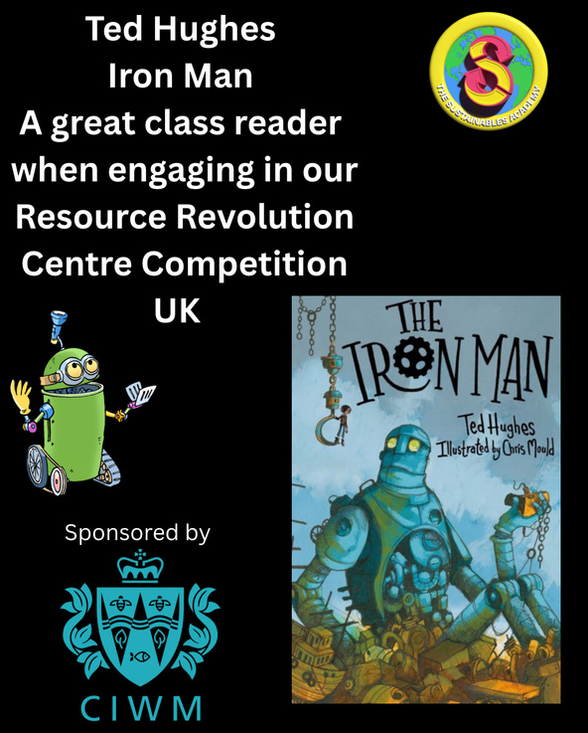
A Great Starting Point for Sustainability Learning
- Resource Revolution Centre Competition:
Supported by the Chartered Institute of Waste Management (CIWM), this competition offers an exciting opportunity to engage learners with sustainability.
The competition encourages individual investigation and inquiry into waste management, making it a great way to start or finish a topic.
We provide resources and guidance to support this competition.
Call to Action:
Use the Resource Revolution Centre Competition as a fun, practical learning opportunity for your learners.

Slide 33
Phenomenon Question:
"How can we creatively solve
real-world problems like
waste by using the ideas and
projects we come up with in school?"

Slide 34
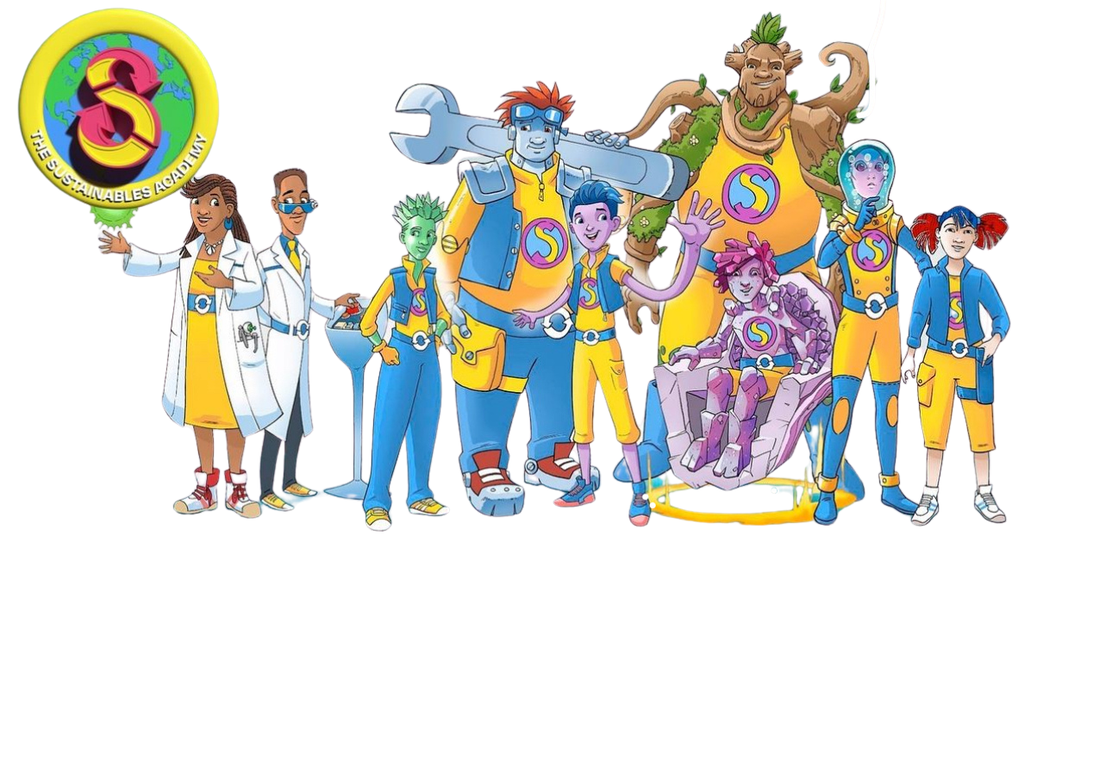
Key Takeaways and Next Steps
Key Points:
    The Sustainables Academy offers a free, not-for-profit curriculum focusing on sustainability, the circular economy, and climate mental health.
    Our curriculum is aligned with global goals, national standards, and diverse educational frameworks.
    The curriculum is designed to be flexible, allowing educators to tailor it to their own teaching environments.
    We advocate for Earth Stewardship, Biosphere Balance, and global empowerment.
    Our growing resources, including YouTube clips and action plans, support teachers and learners in their sustainability journey.

Slide 35
Next Steps:
    Explore our resources on www.thesustainablesacademy.org.
    Subscribe to our YouTube channel and start using the clips in your classroom.
    https://www.youtube.com/watch?v=MV9WwoHvmKY
    Engage with the Resource Revolution Centre Competition to kickstart sustainability projects in your school.
    Empower your learners with the knowledge and skills they need to take action on sustainability.

Slide 36


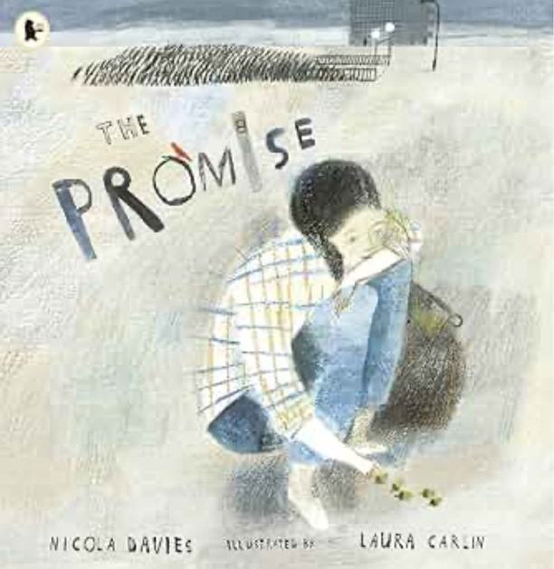

Slide 37
www.thesustainablesacademy.org

